Slide 1
Mw6.0 pre-event of 2024 Noto Penisula earthquake

Slide 2
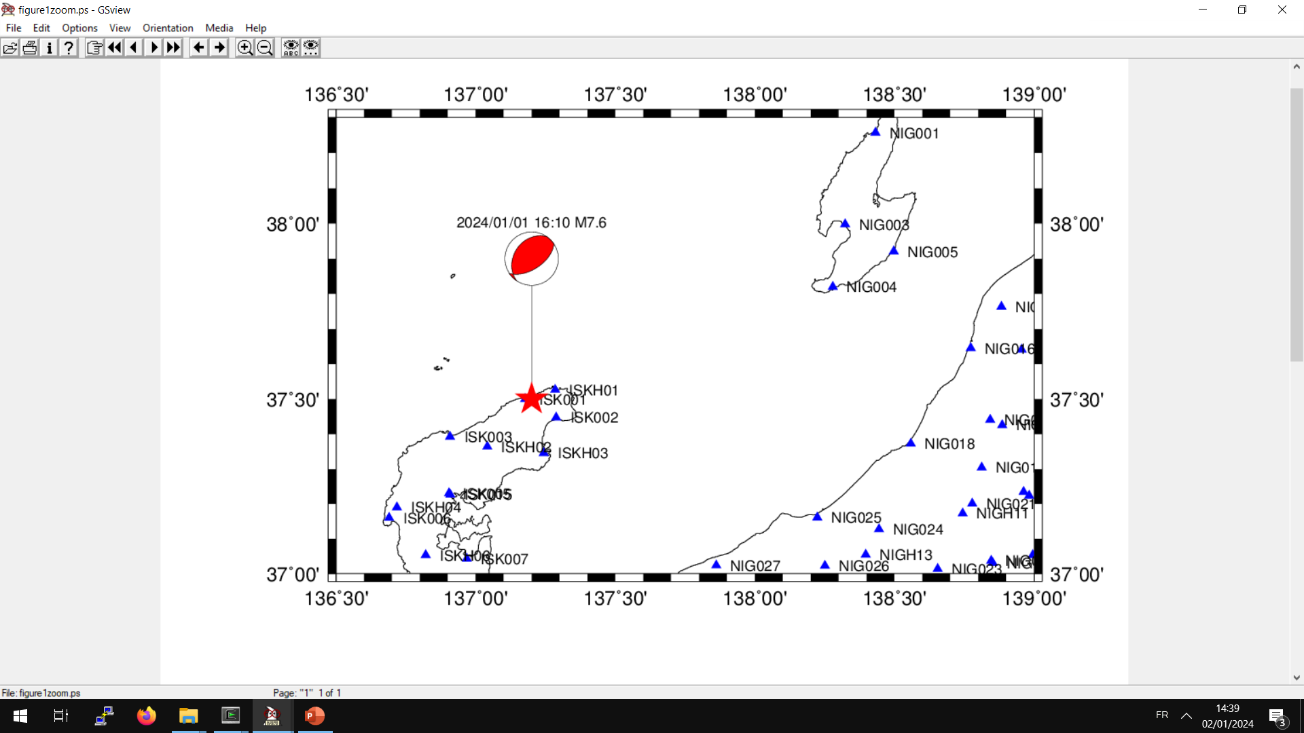
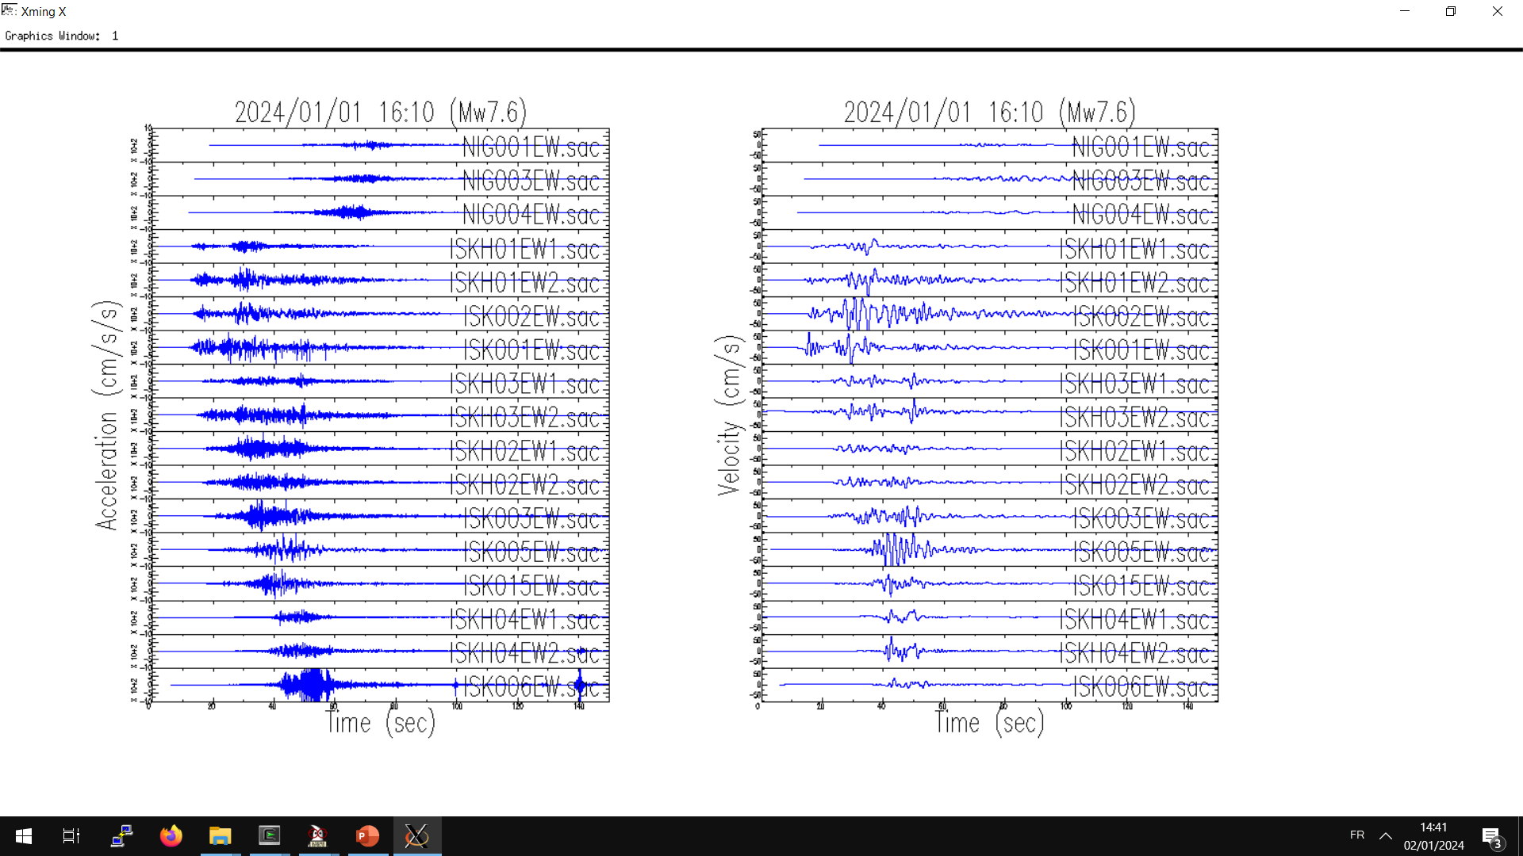
Near-field ground motions
Sado island
Velocity filtered
between 0.03 and 30 Hz
Acceleration
Noto Peninsula
1
3
2
Y-axis max +-1000 cm/s²
Y-axis max +-80 cm/s

Slide 3
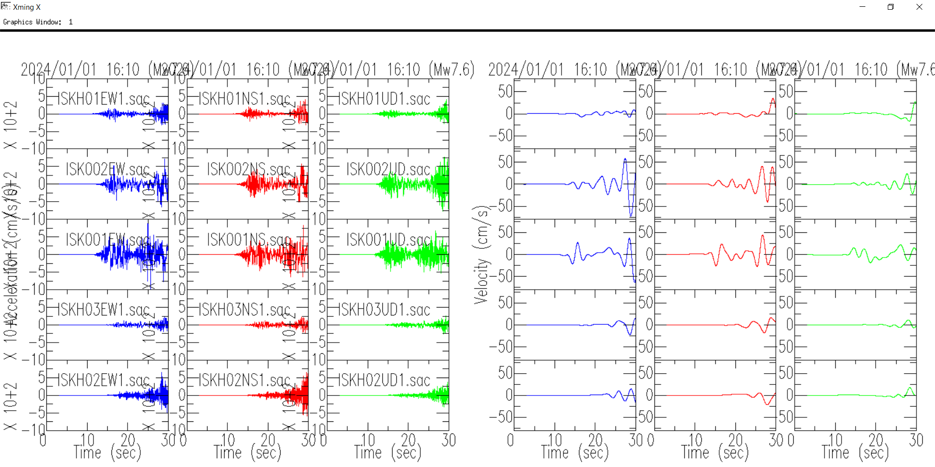
0.05-0.5
2024 1 1 16:10 8.3 37°31.0'N 137°14.4'E 10 - 能登半島沖
2024 1 1 16:10 9.5 37°30.4'N 137°13.8'E 10 5.9 石川県能登地方
2024 1 1 16:10 22.5 37°29.7'N 137°16.2'E 16 7.6 石川県能登地方
JMA catalog

Slide 4
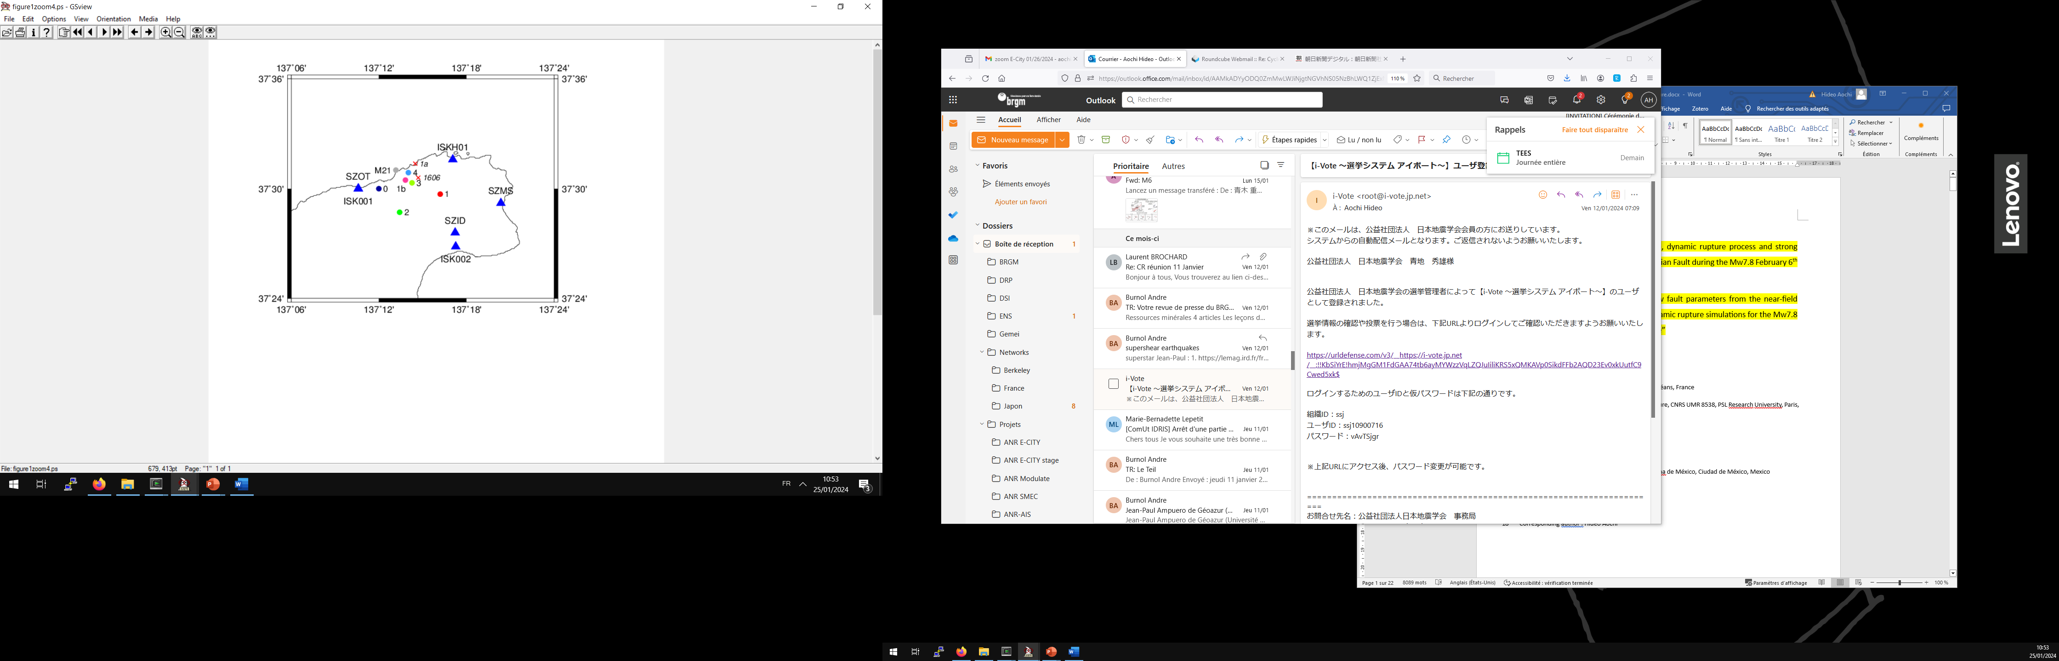
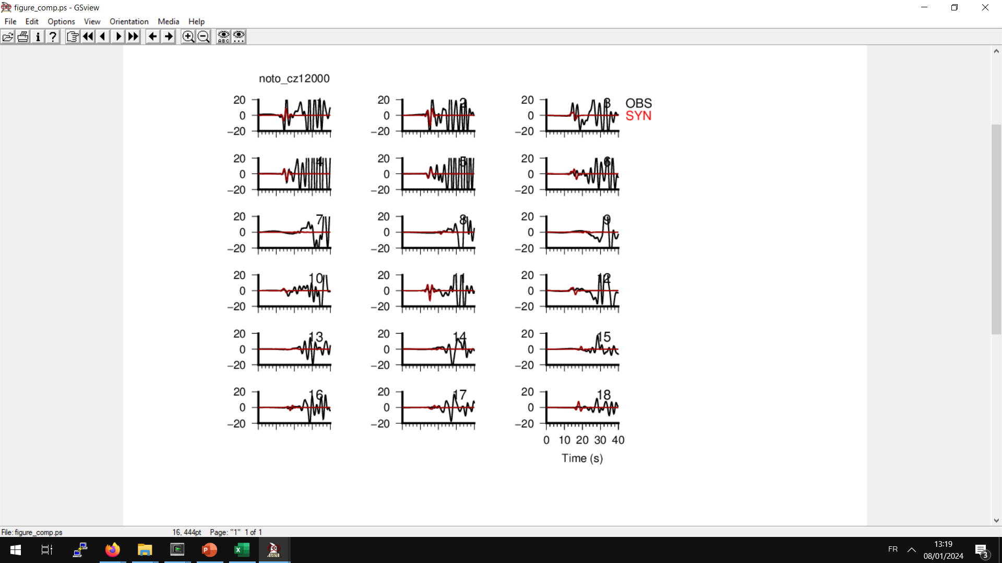
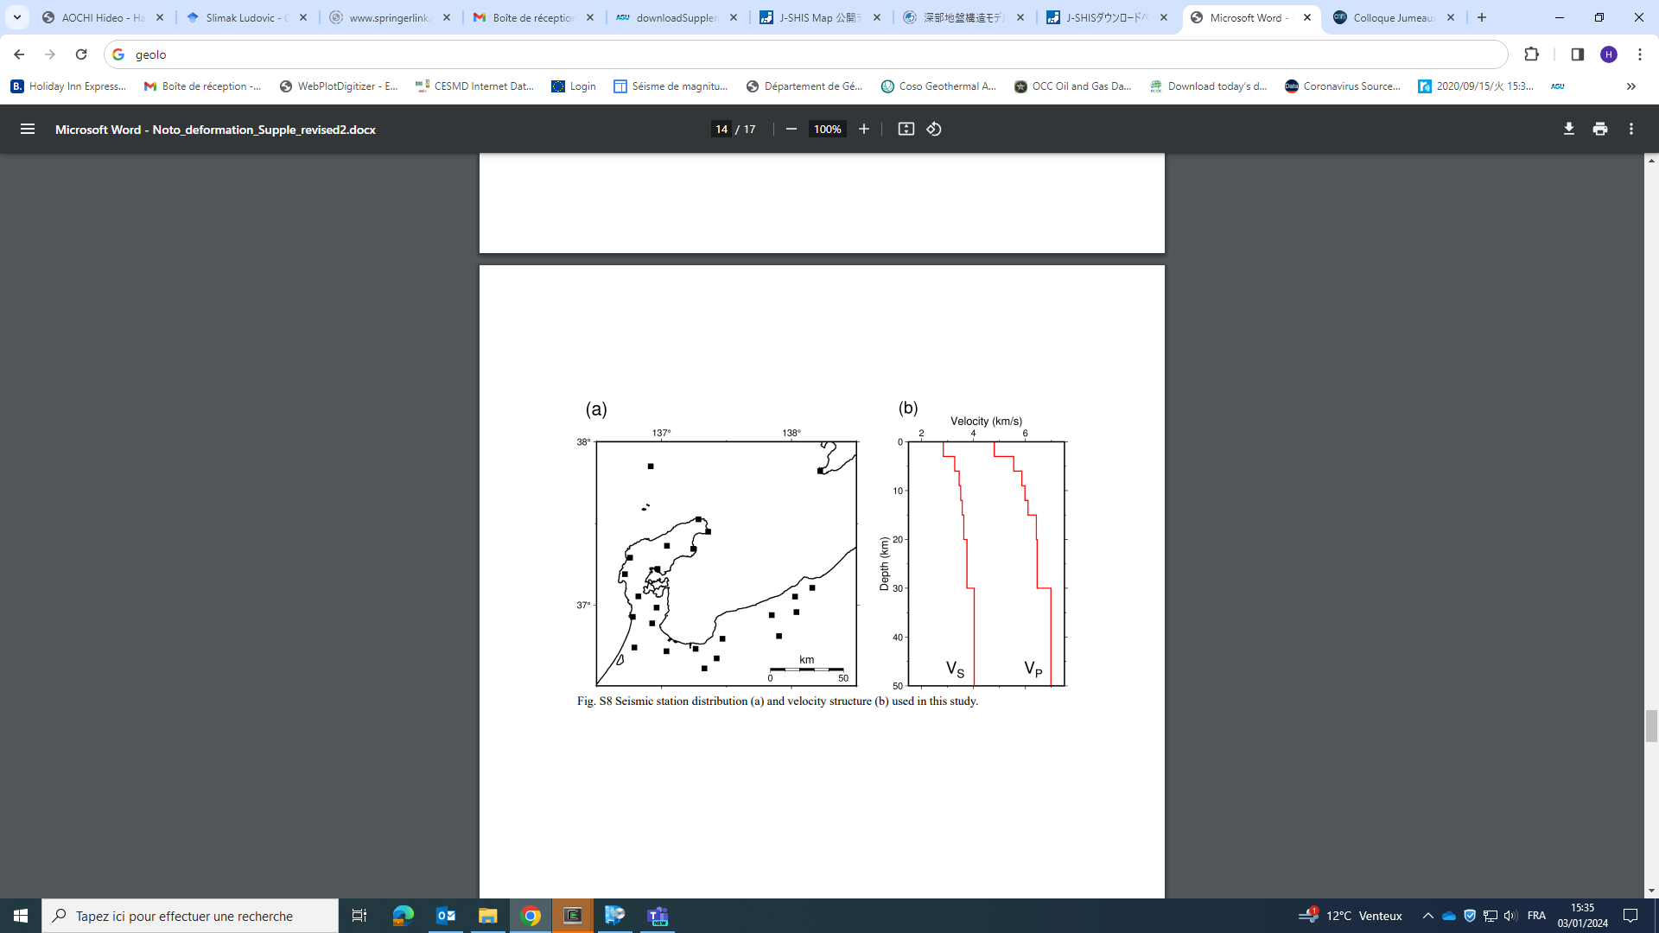
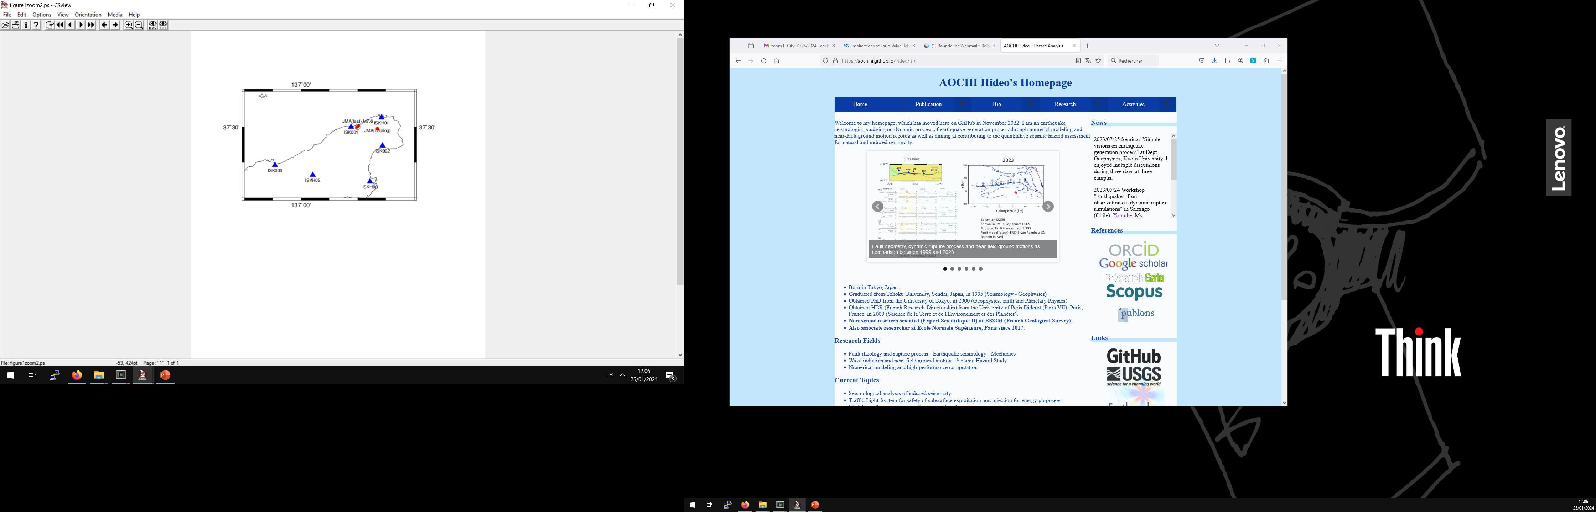
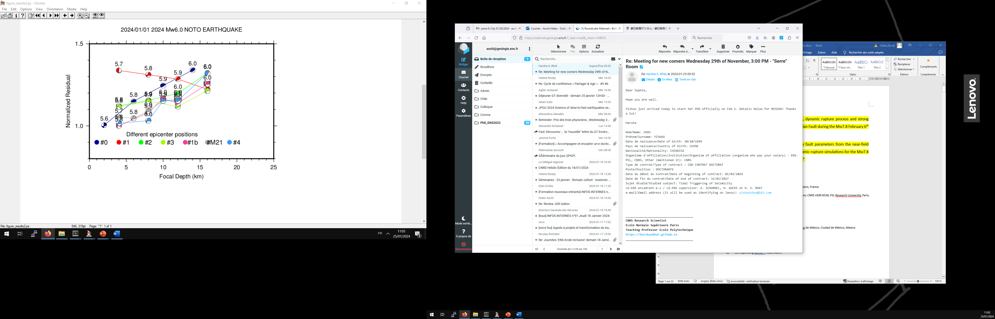
Focal mechanism by full waveforms
Position #3, depth =12 km
EW
NS
UD
#1 = JMA M7.6
#1b = JMA M5.9
Vel (cm/s)
1D structure by Nishimura et al. (2023)
ISK001
ISK002
ISKH01
ISKH01
ISKH02
ISKH03
Waveforms filtered between 0.05 – 0.5 Hz
Fitting only between 10-20 seconds
Focal mechanism inversion (strike, dip, rake, t0, Mw)

Slide 5
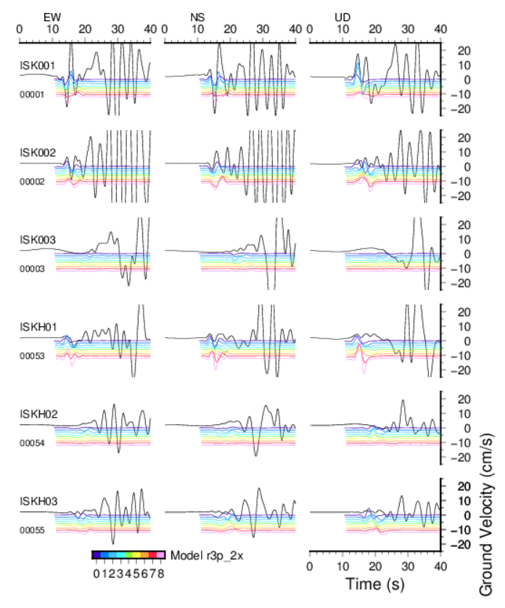
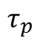
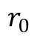
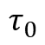
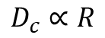
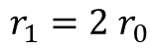
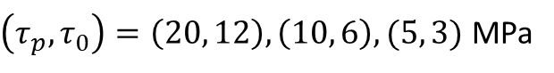
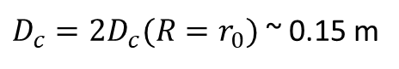
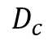
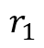
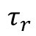
Dynamic rupture inversion by patch
0.05-0.5 Hz
10-20 sec
Nucleation patch (self-similar)
shear stress
$$r_{0}$$
$$τ_{p}$$
$$D_{c}∝R$$
$$τ_{0}$$
Target patch
$$τ_{r}$$
$r_{1}=2$ $r_{0}$
$$D_{c}$$
slip
$$r_{1}$$
$D_{c}=2D_{c}(R=r_{0})$ ~ 0.15 m
$\left(τ_{p},τ_{0}\right)=\left(20, 12\right), \left(10, 6\right),(5, 3)$ MPa
Rupture directivity
Slip direction
1
Model 0
8

Slide 6
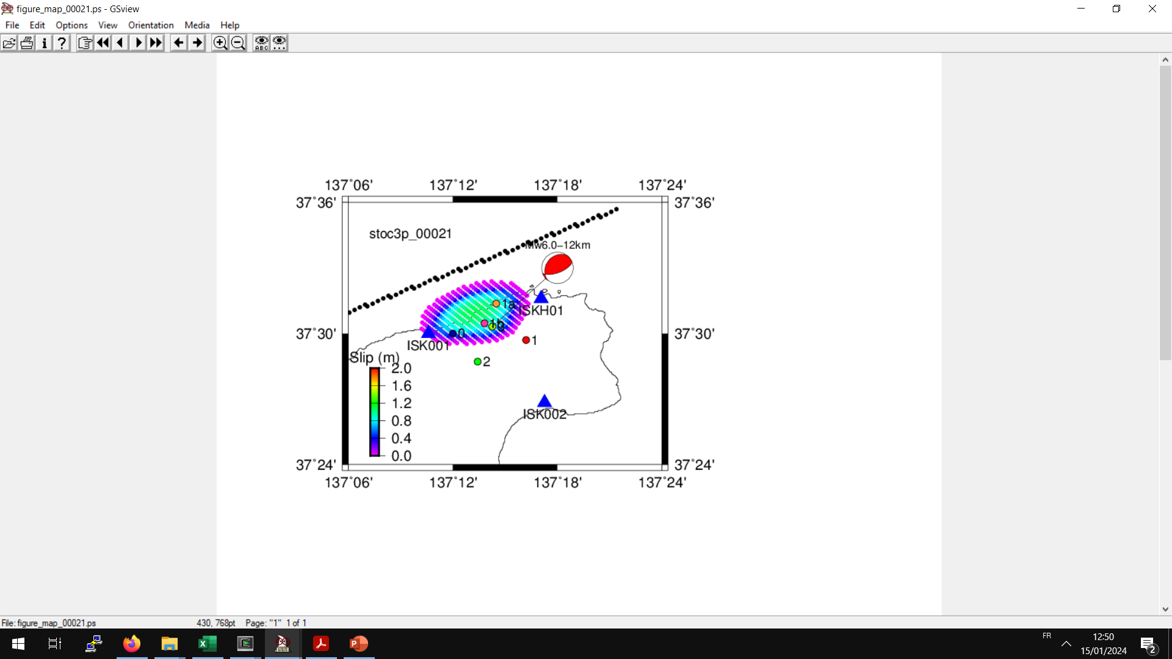
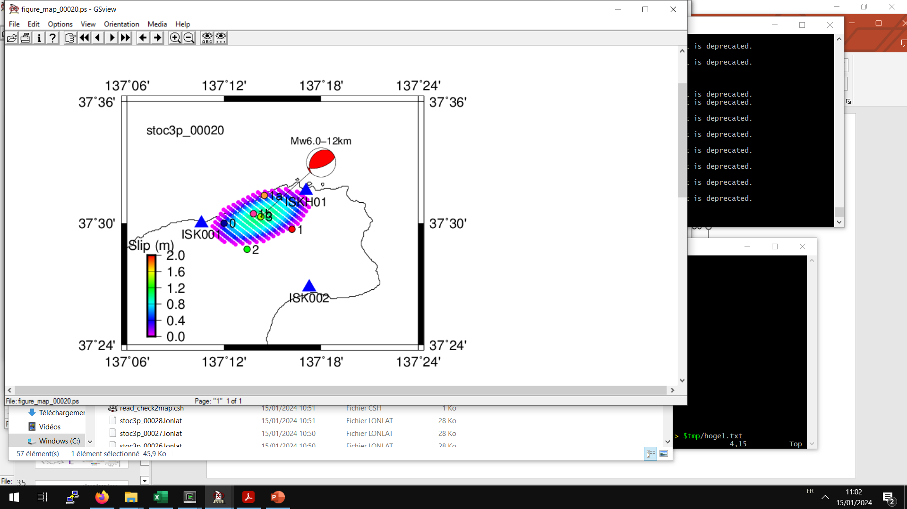
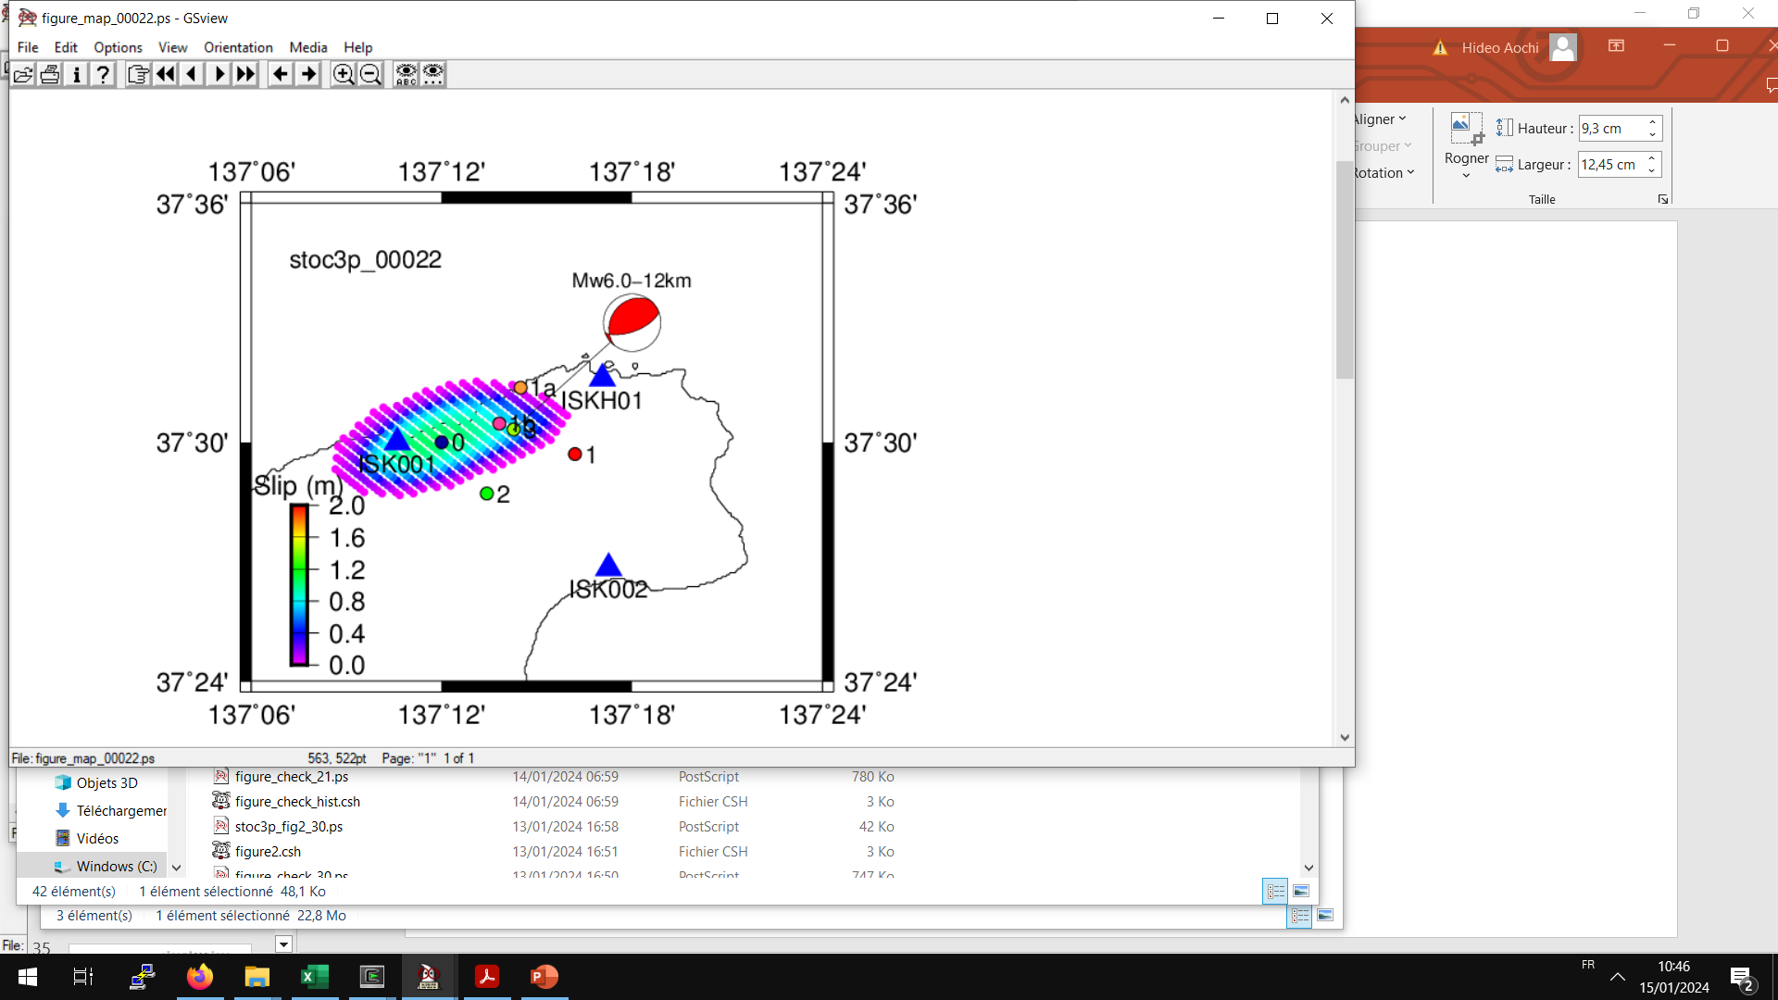
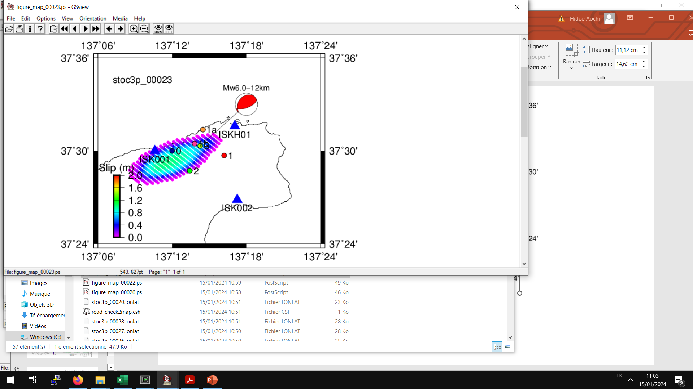
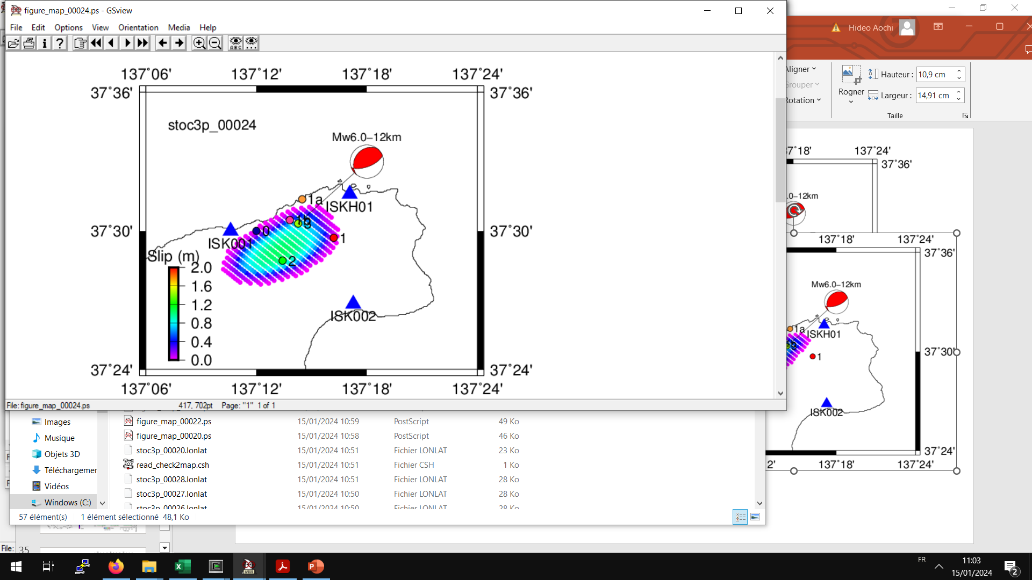
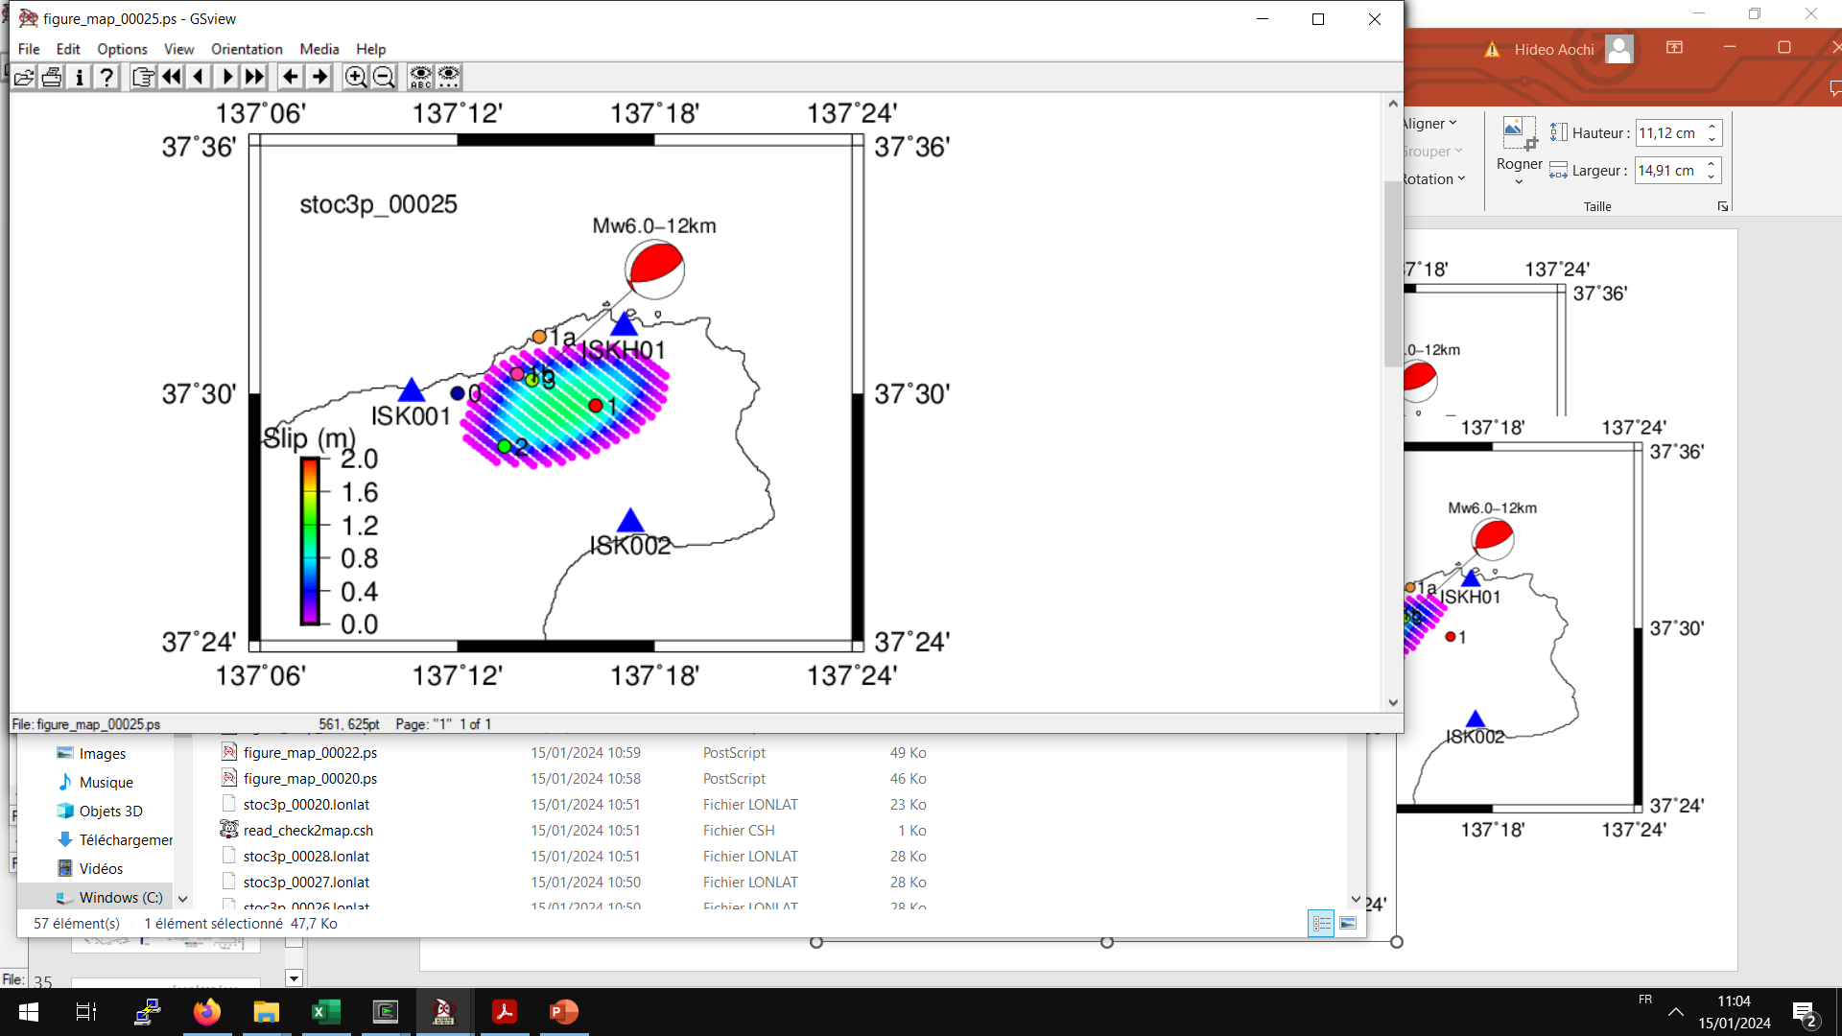
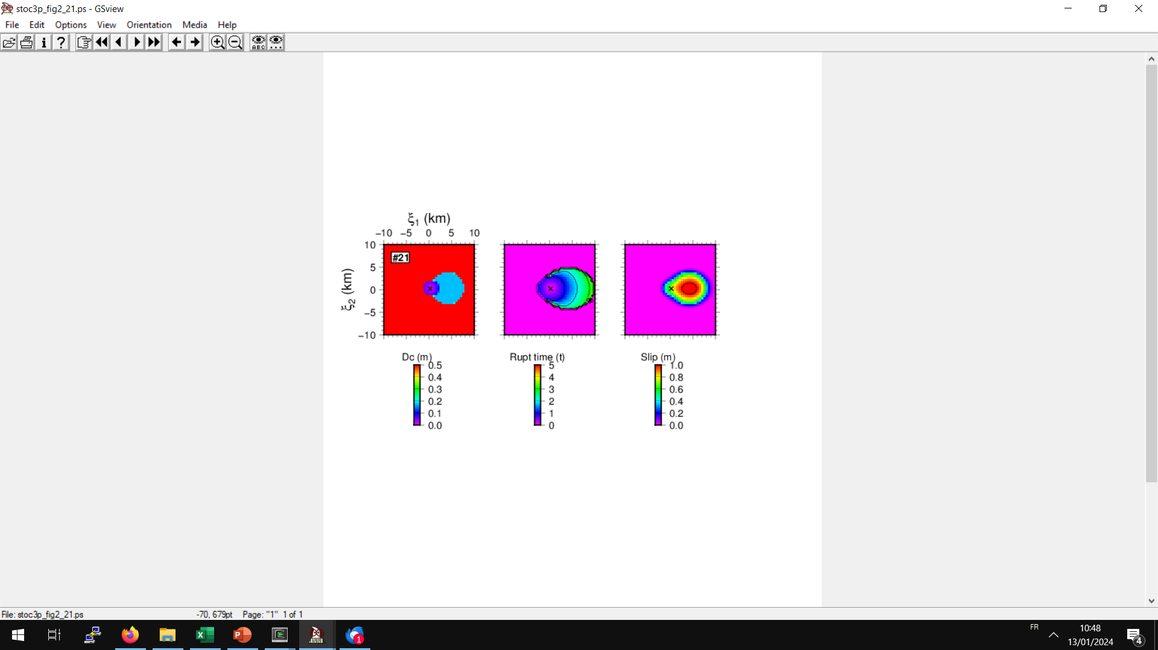
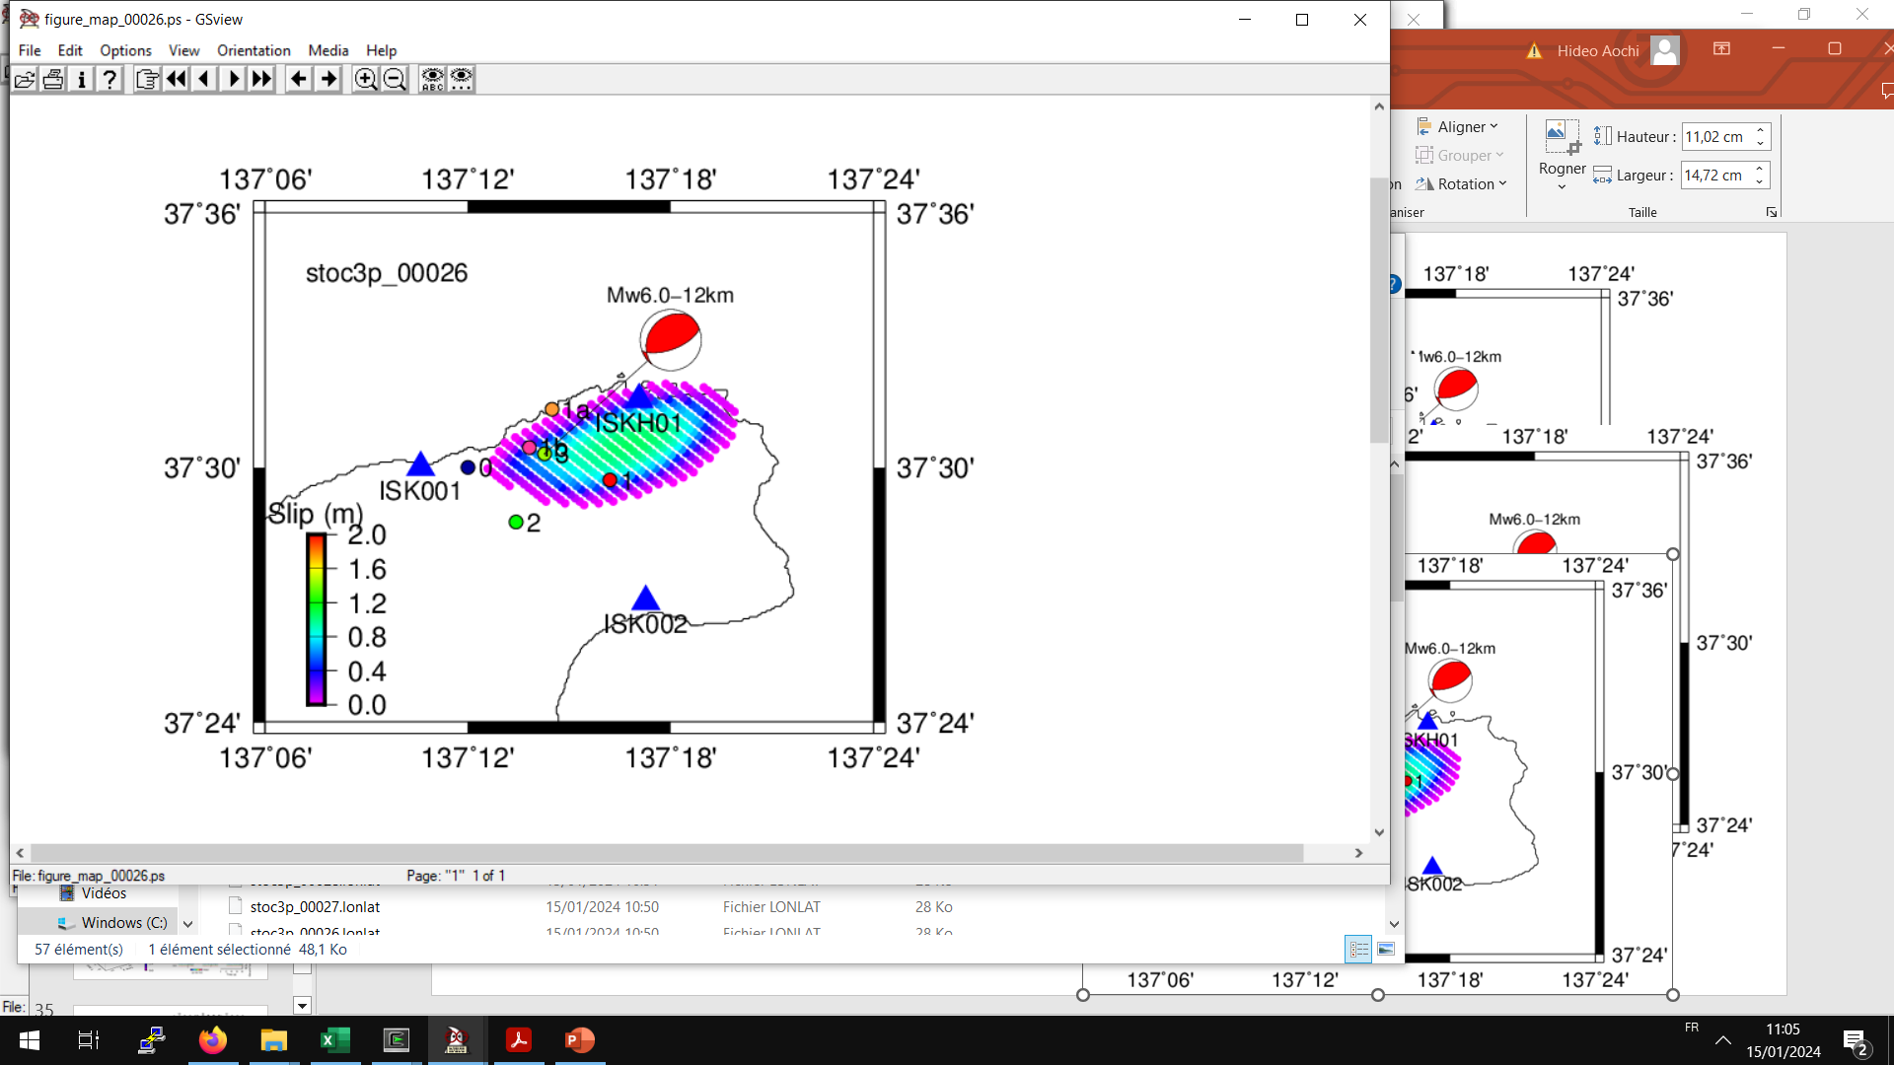
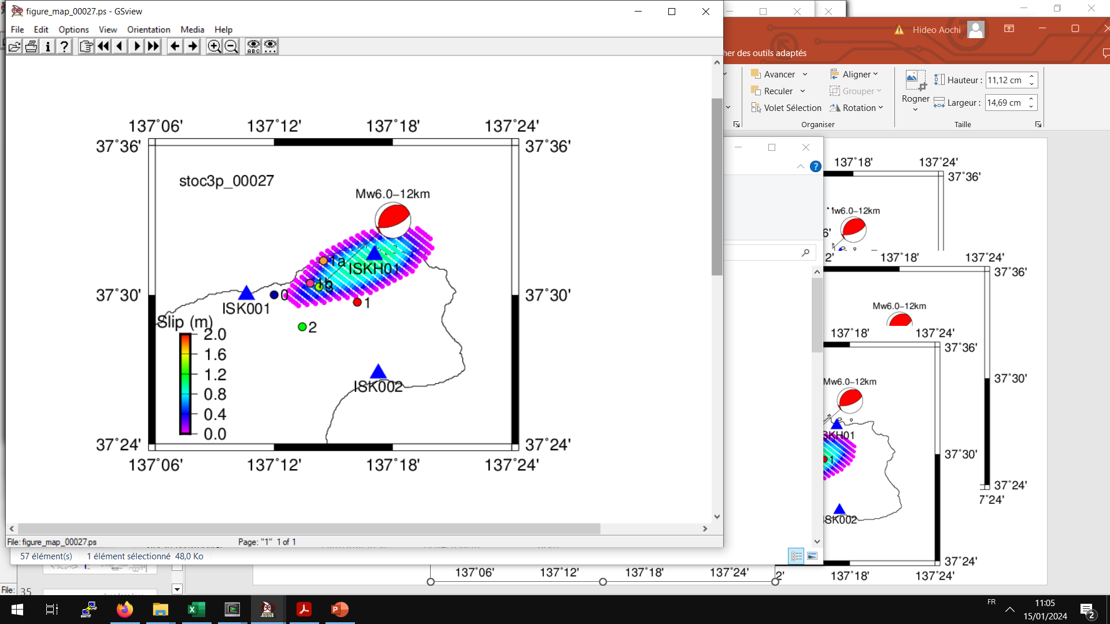
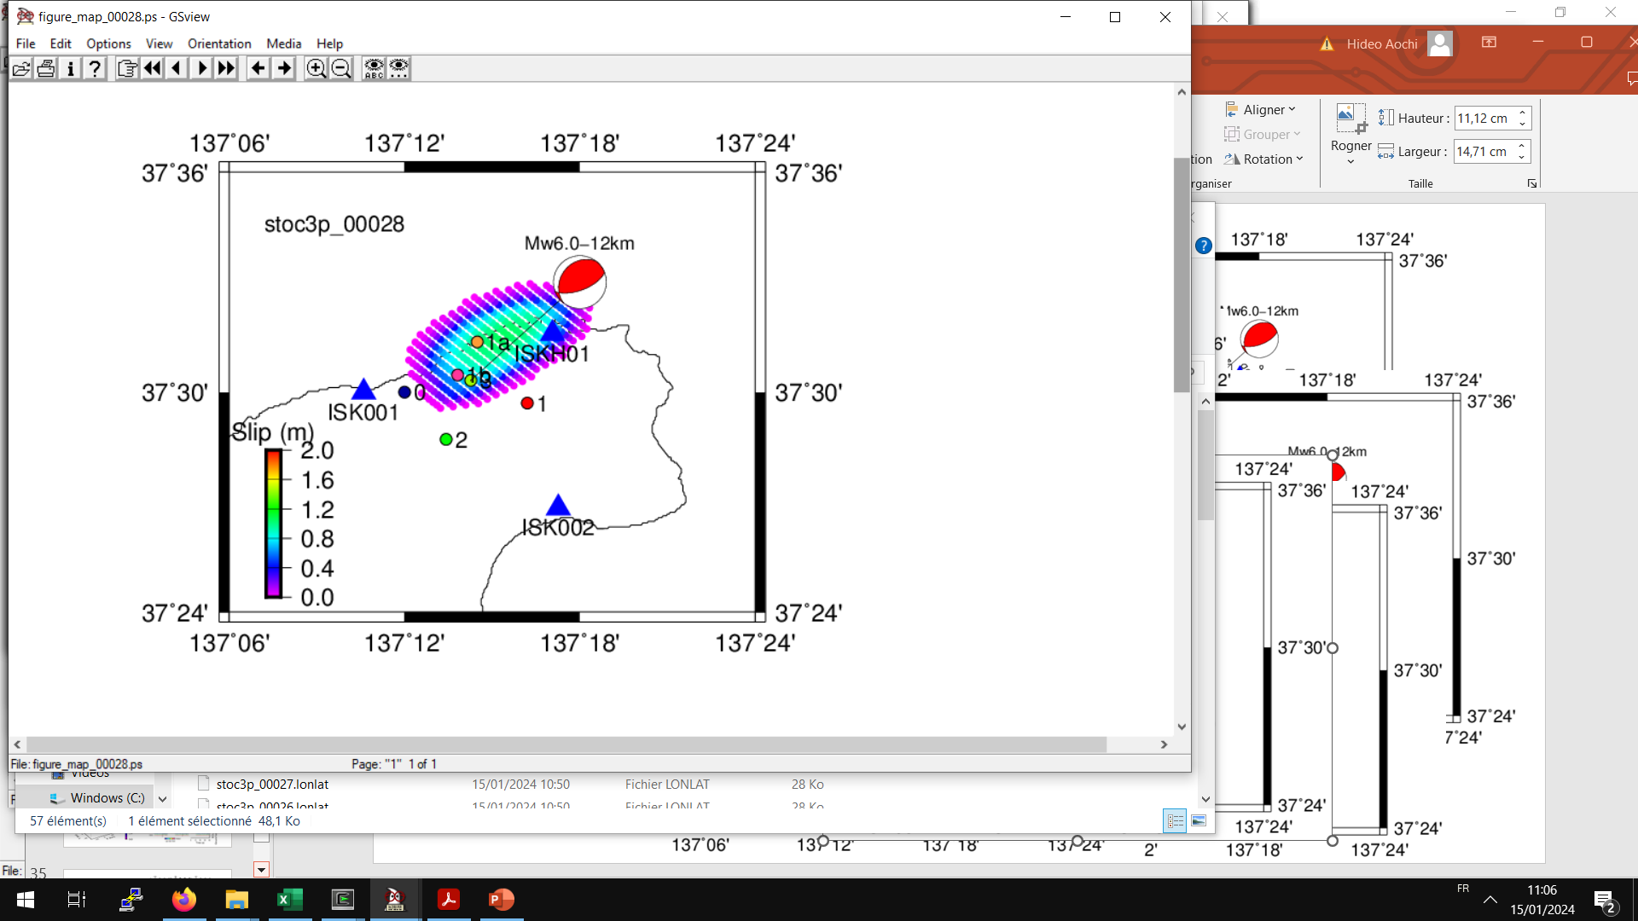
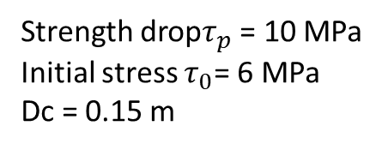
Test 1
Model 1: (69°, 65°, 104°)
Rupture directivity
Strength drop$τ_{p}$ = 10 MPa
Initial stress $τ_{0}$= 6 MPa
Dc = 0.15 m
Mw6.03 (not contolled, not optimized)

Slide 7
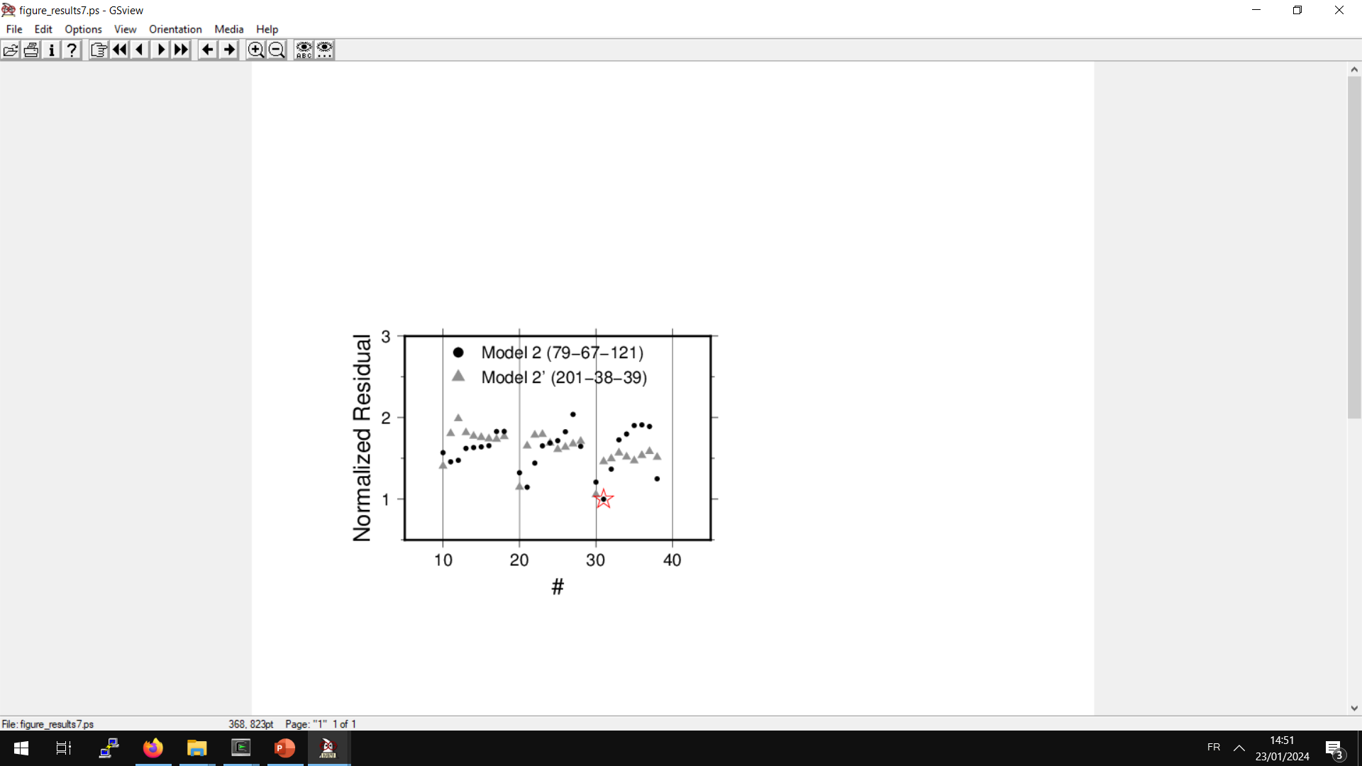
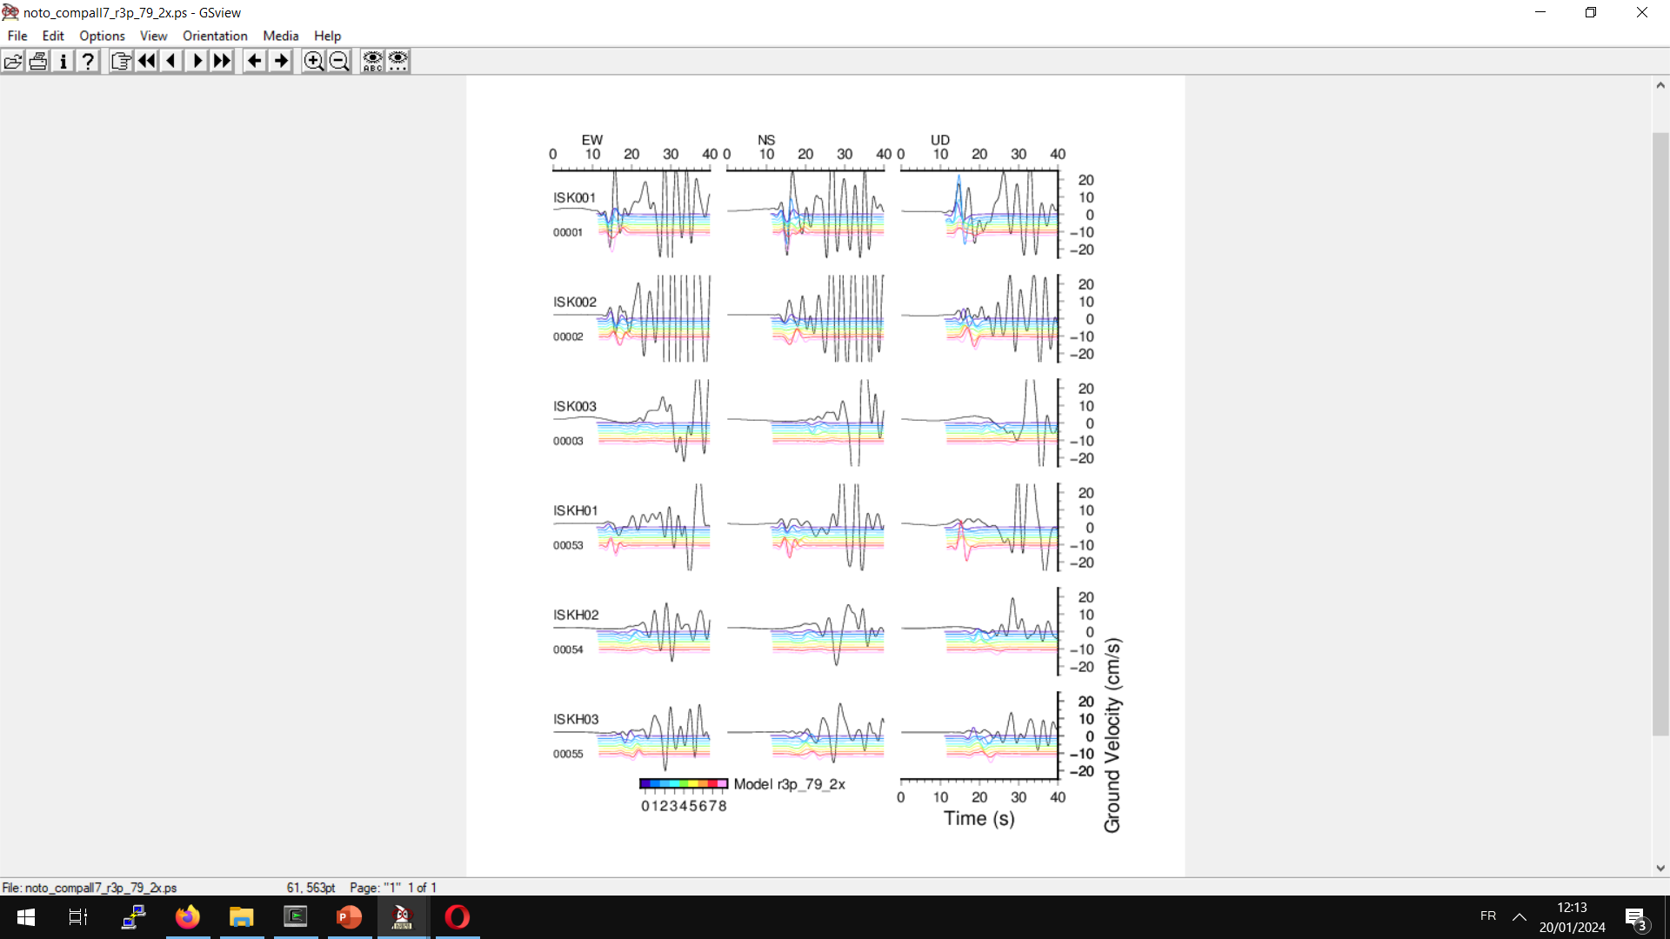
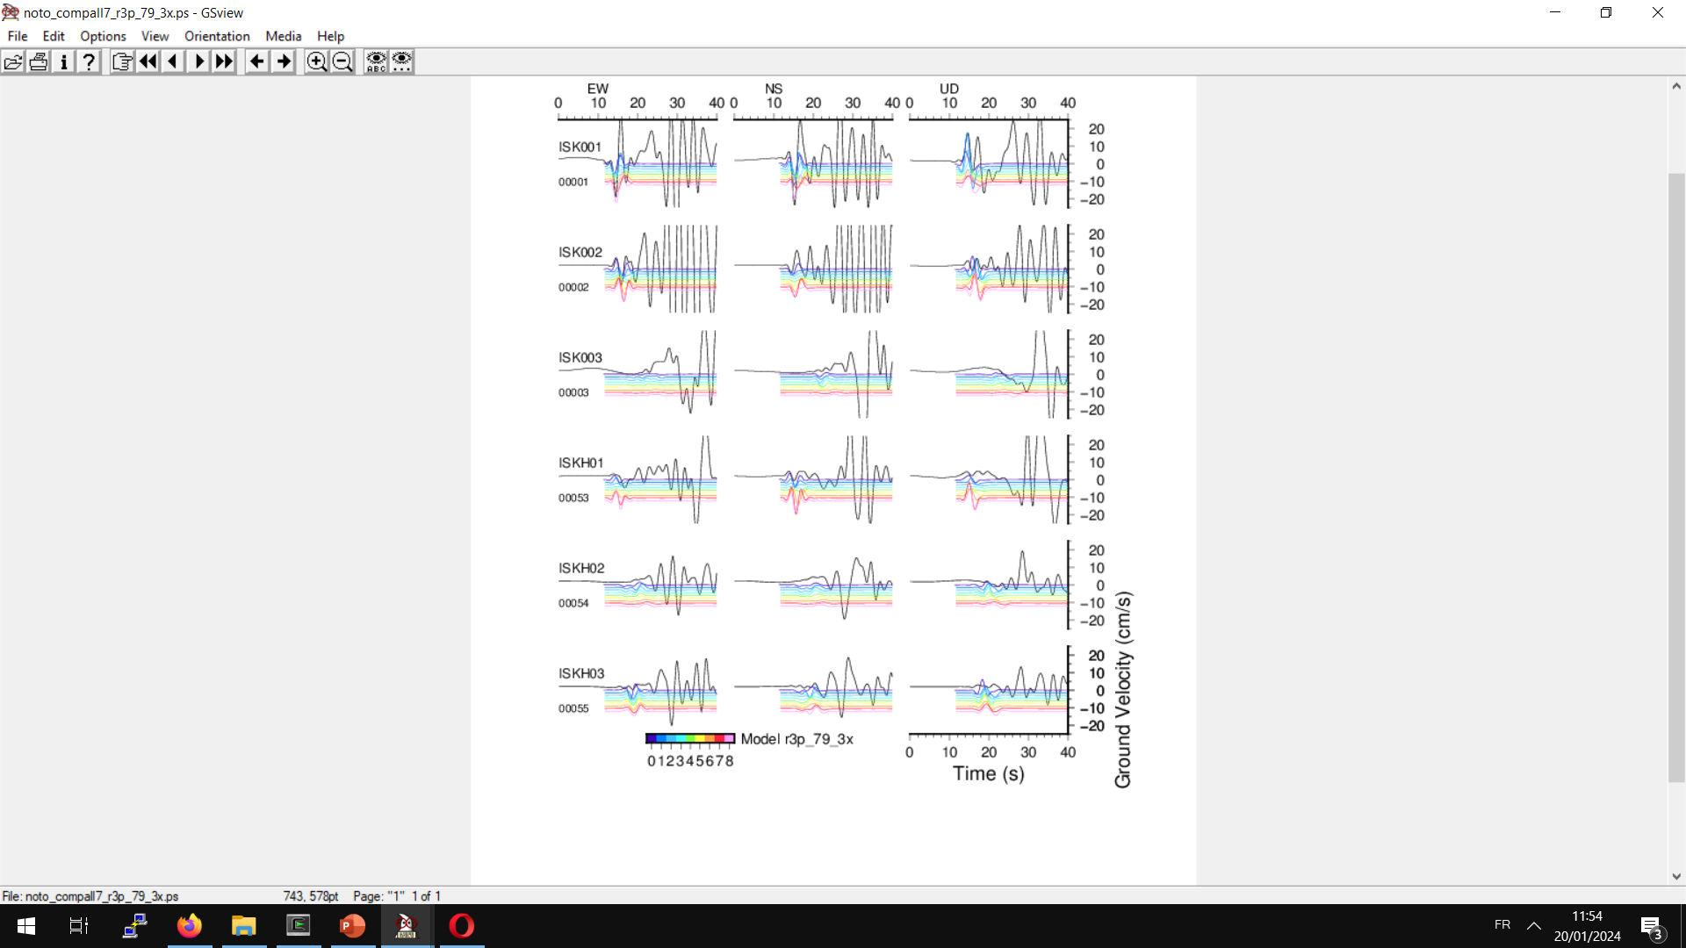
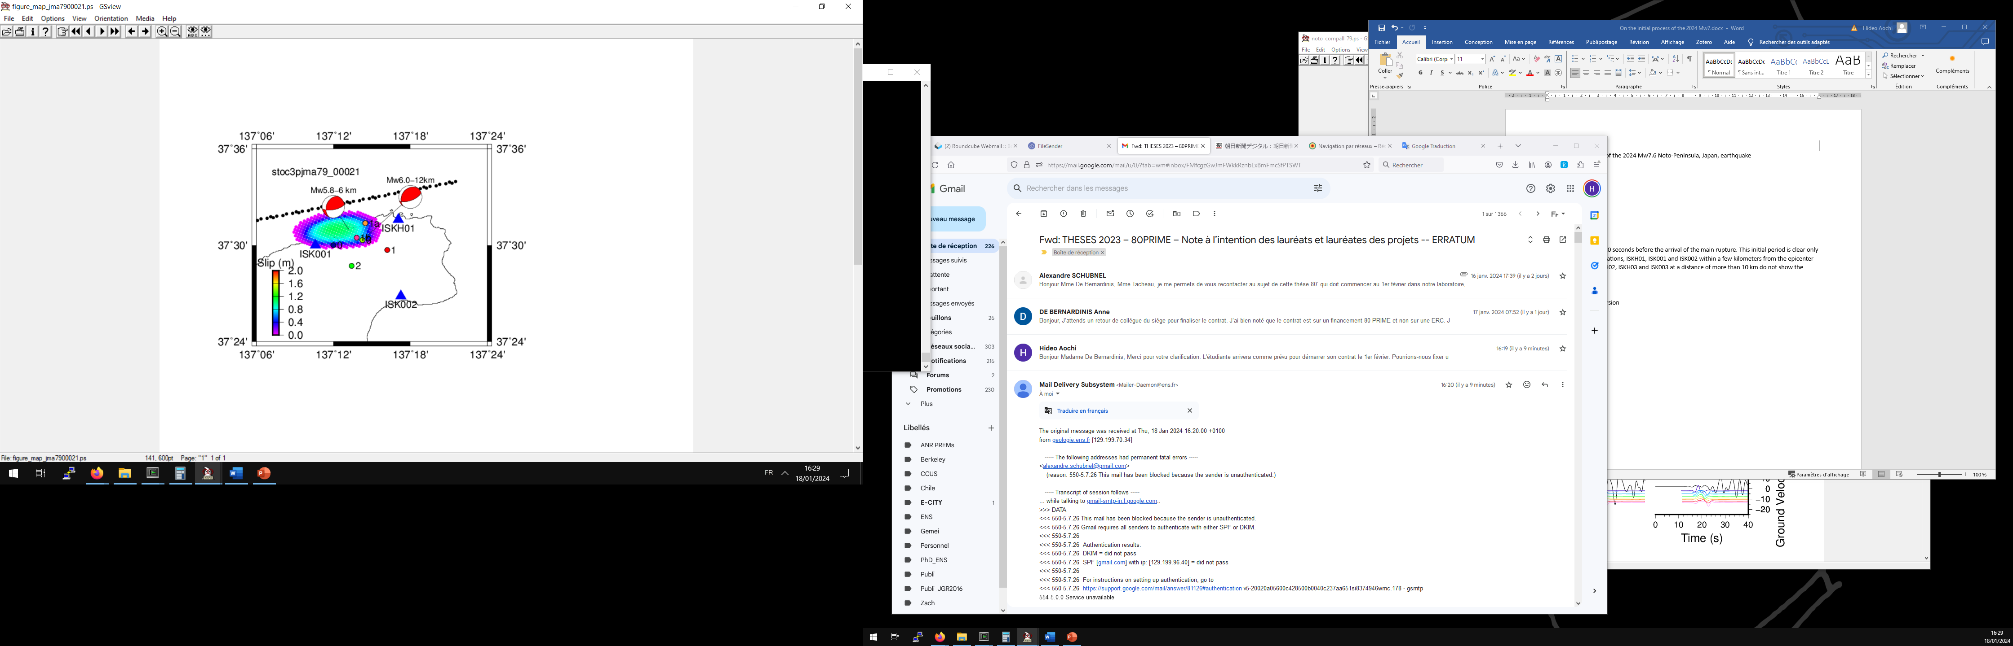

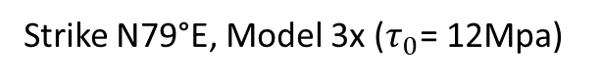
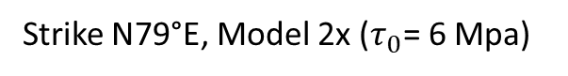
High stress drop
Test 2 (79°, 67°, 121°)
Strike N79°E, Model 2x ($τ_{0}$= 6 Mpa)
Strike N79°E, Model 3x ($τ_{0}$= 12Mpa)
Fitting 0.05-0.5 Hz, 10-20 sec

Slide 8
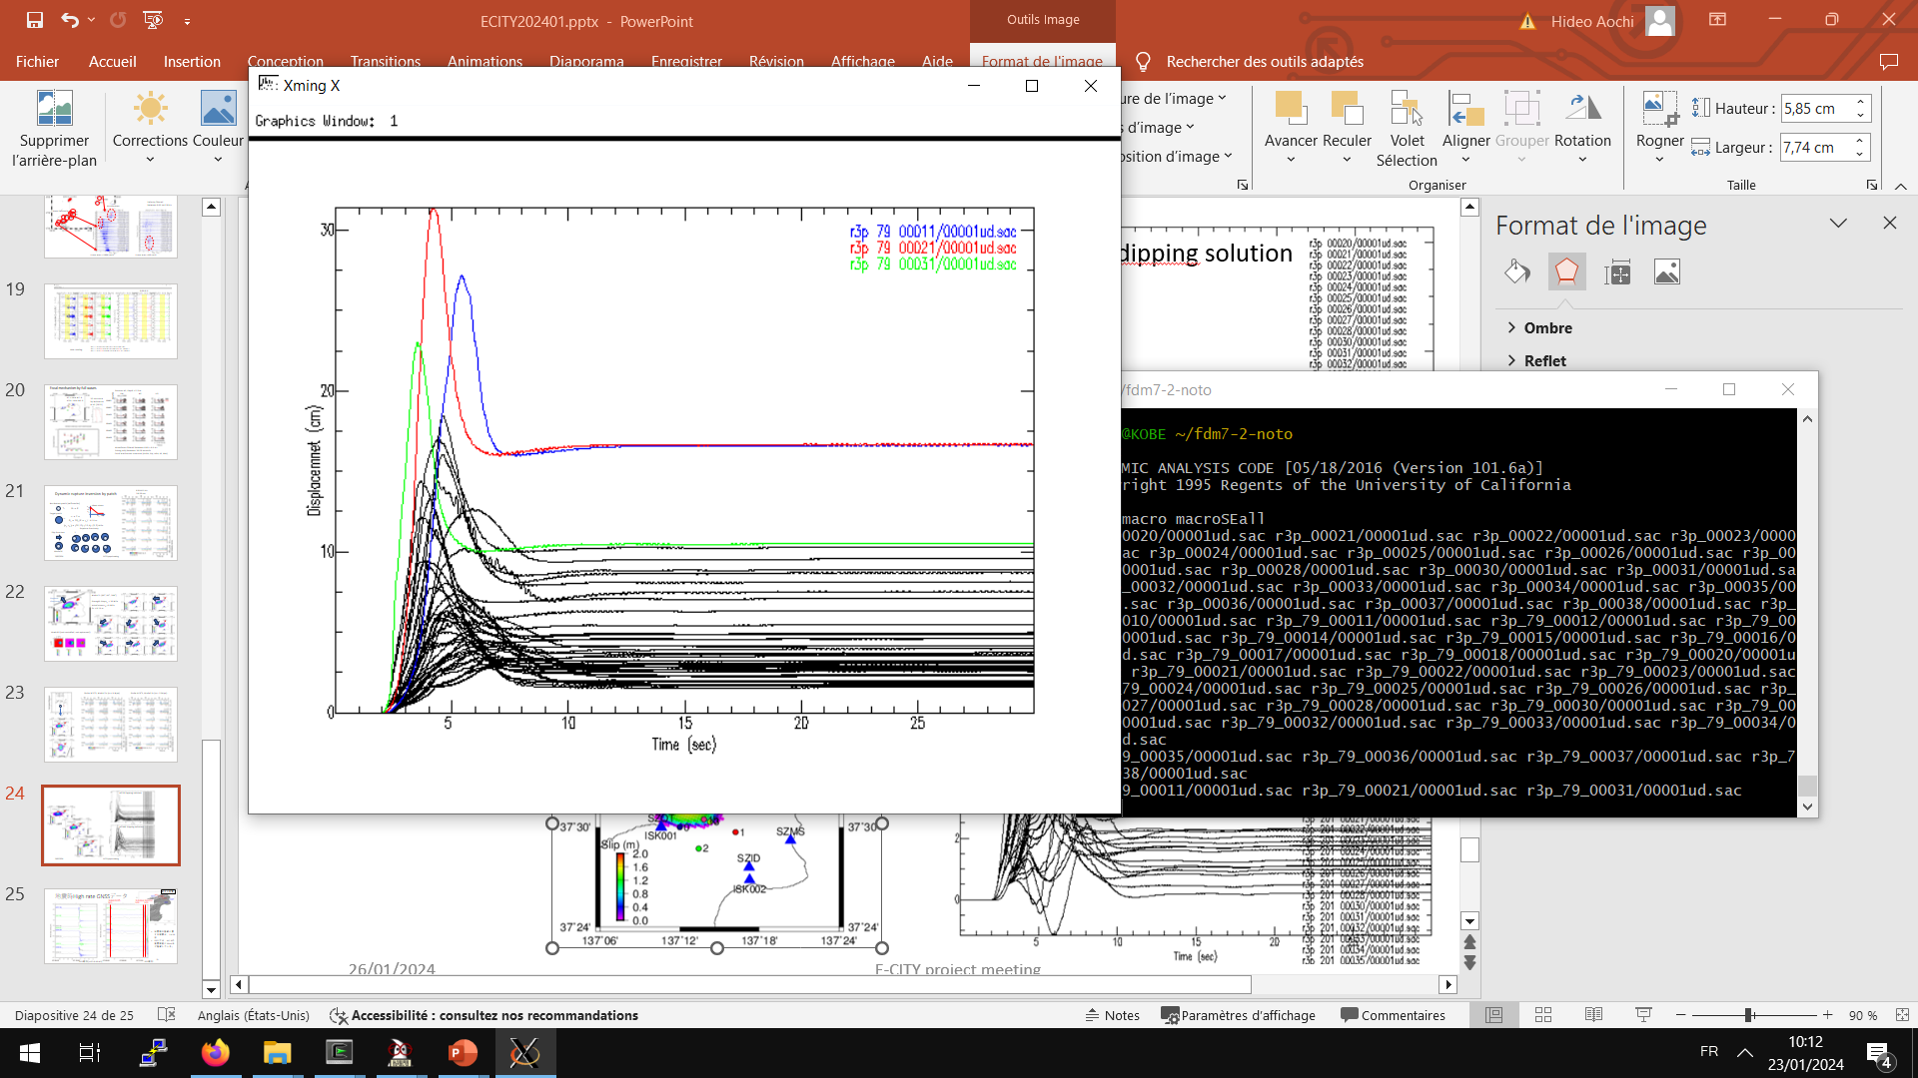
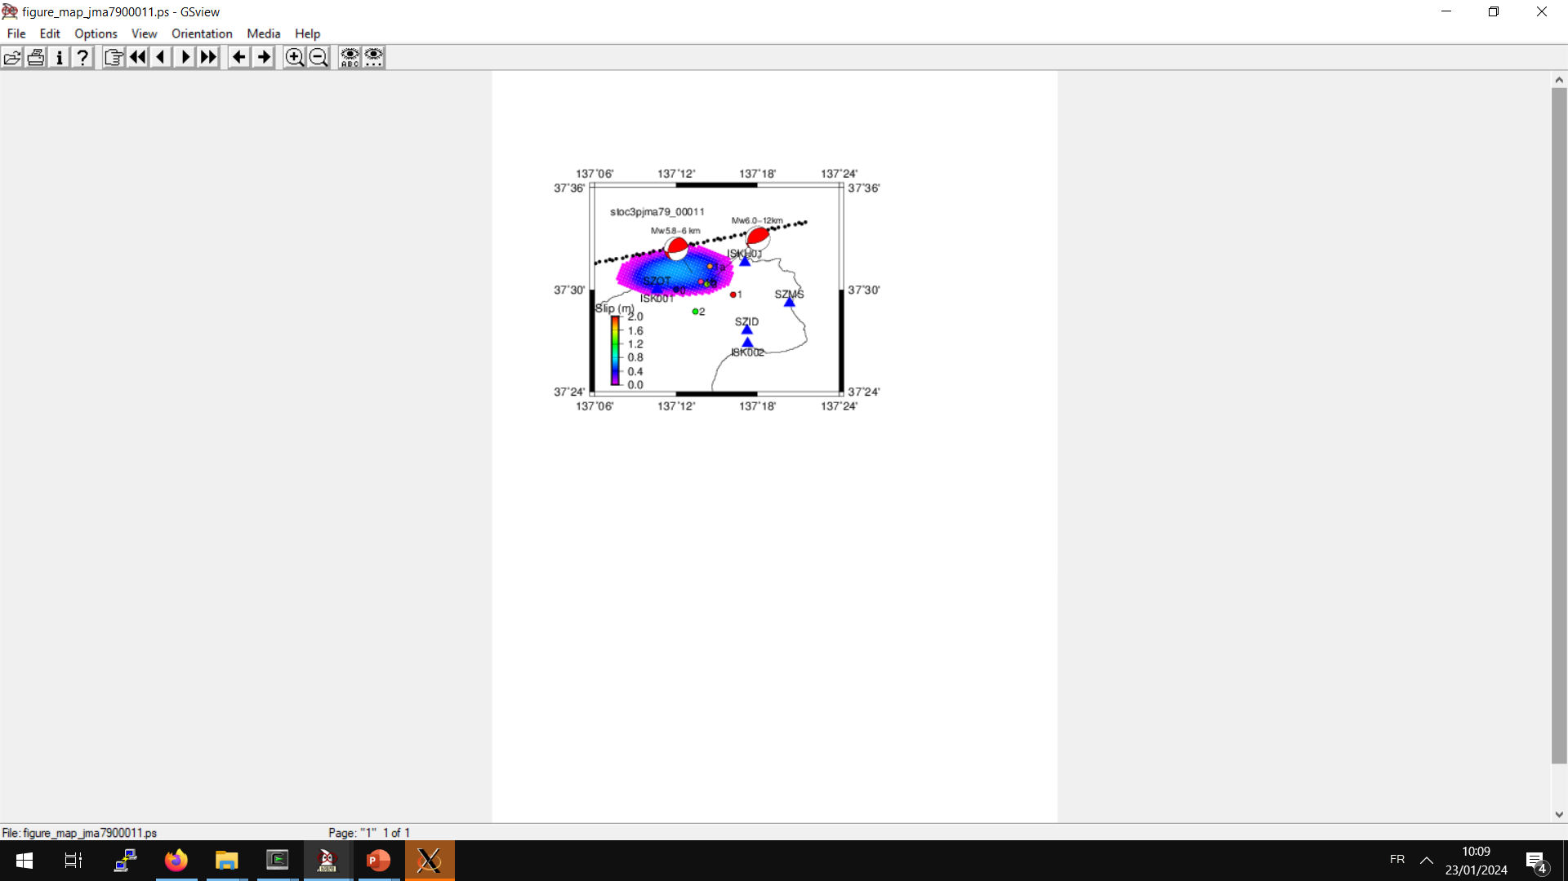
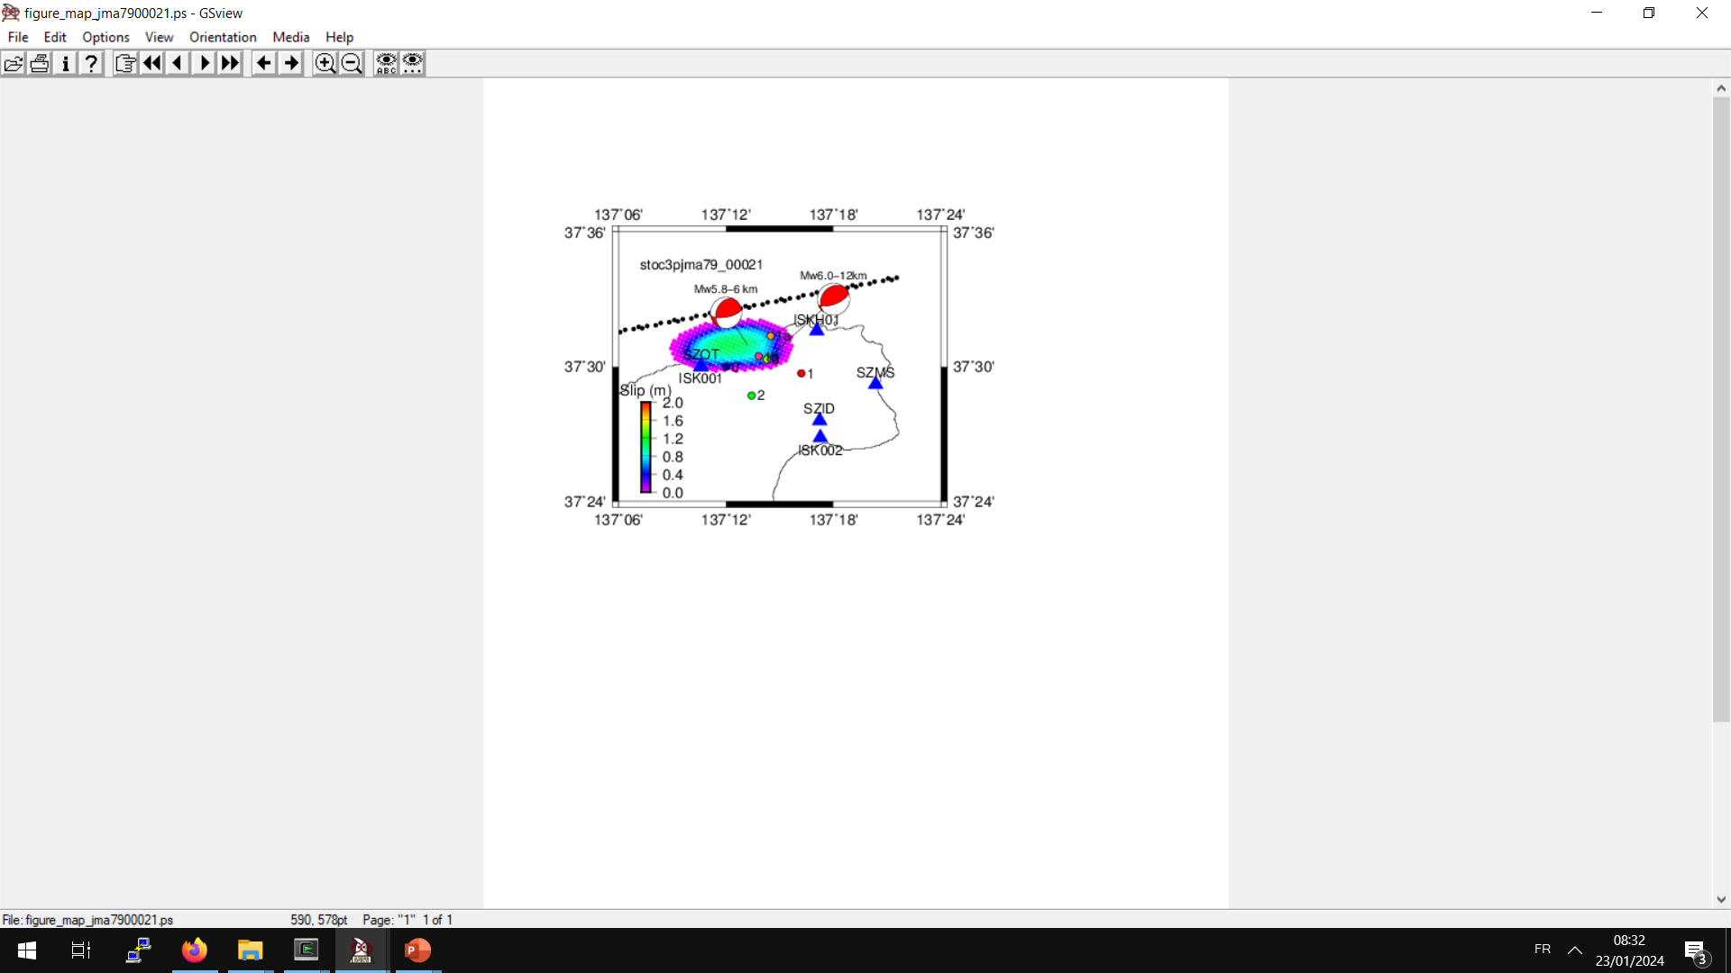
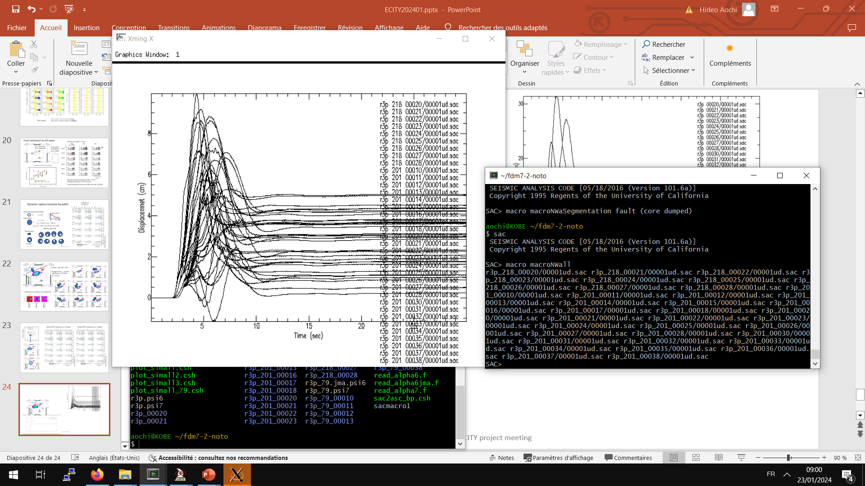
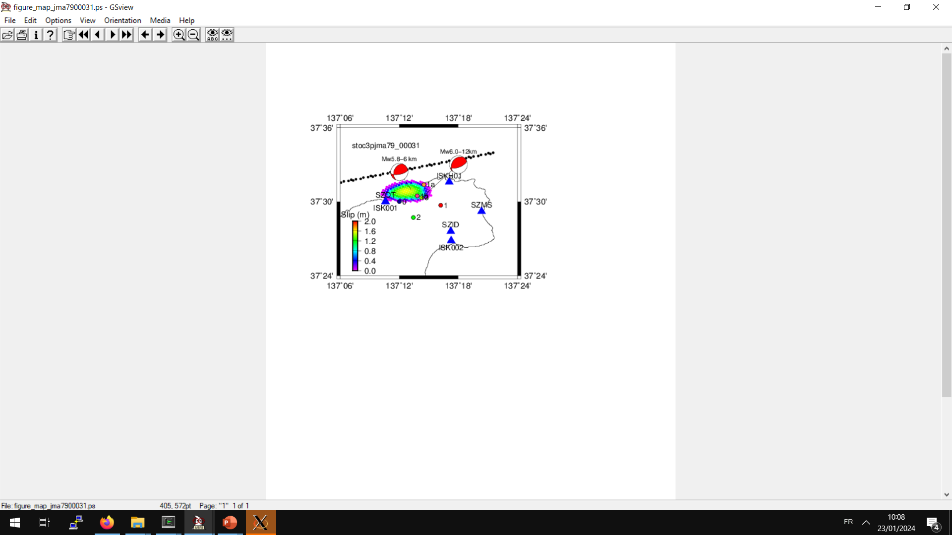
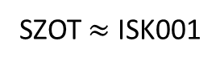
Vertical Displacement
SZOT $≈$ ISK001
All SE dipping solution
2
1
About 30 cm uplift before the mainshock (DPRI)
Test 2 (79°, 67°, 121°) from JMA hypocenter
3
1 (Mw6.026)
Uz (cm)
2 (Mw6.034)
All NW dipping solution
3 (Mw5.978)
High stress drop

Slide 9
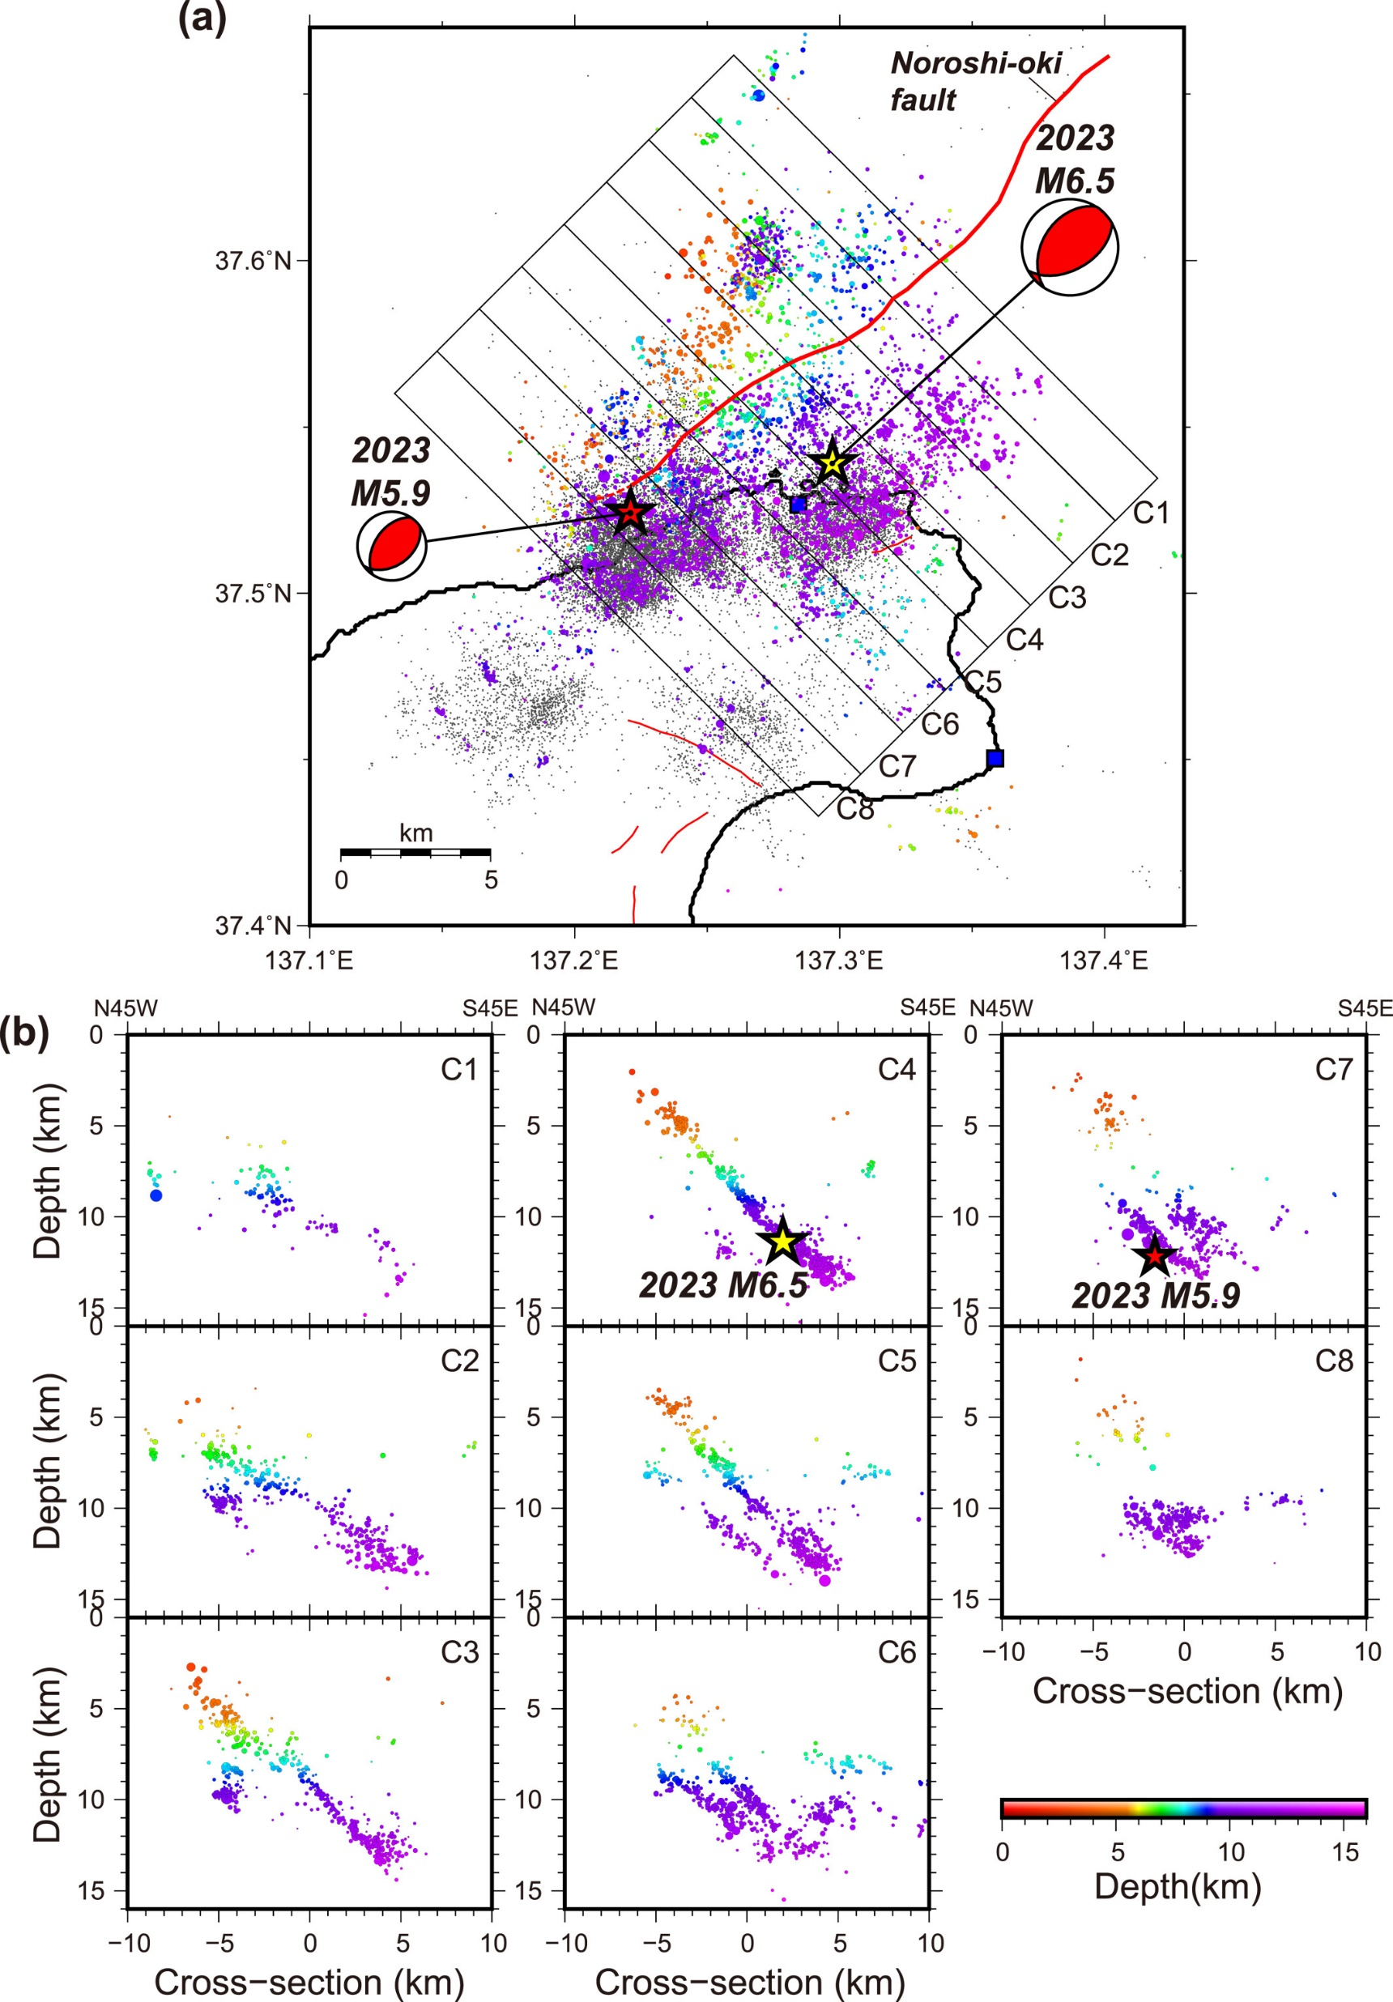
Where is the causal fault?
Test 2 (79°, 67°, 121°) from JMA hypocenter
Kato et al. (2023)

Slide 10
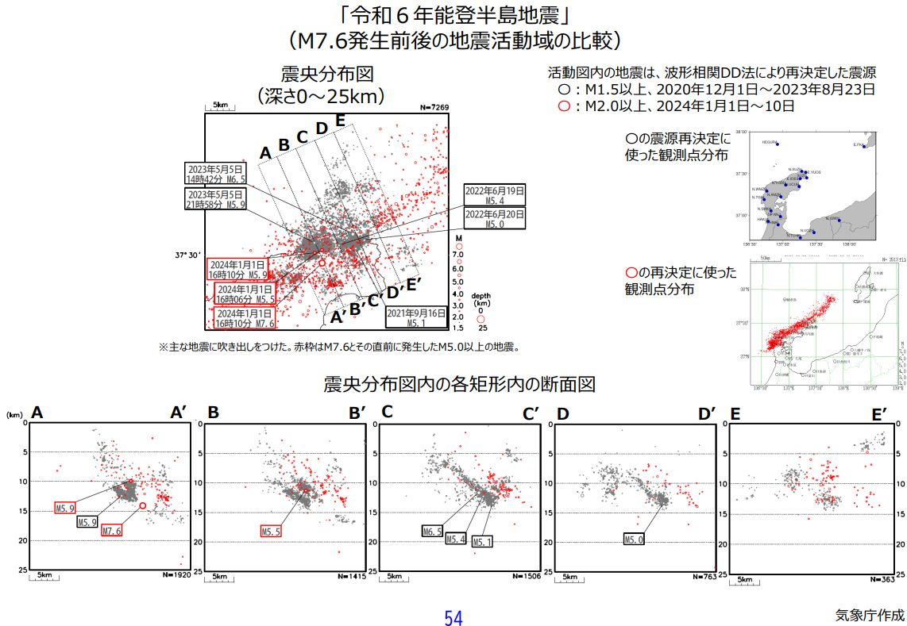
Where is the causal fault?
JMA
Other models
Model strike-dip-rake (°)
1_SW 46.9-26.0-124.4
1_NE 56.9-59.0-99.3
2 56-33-125
3 47-37-100
4 52-42-variabe
5 47-46-variable
Tested
1 69-65-104
2 79-67-121
3 56-33-125

Slide 11

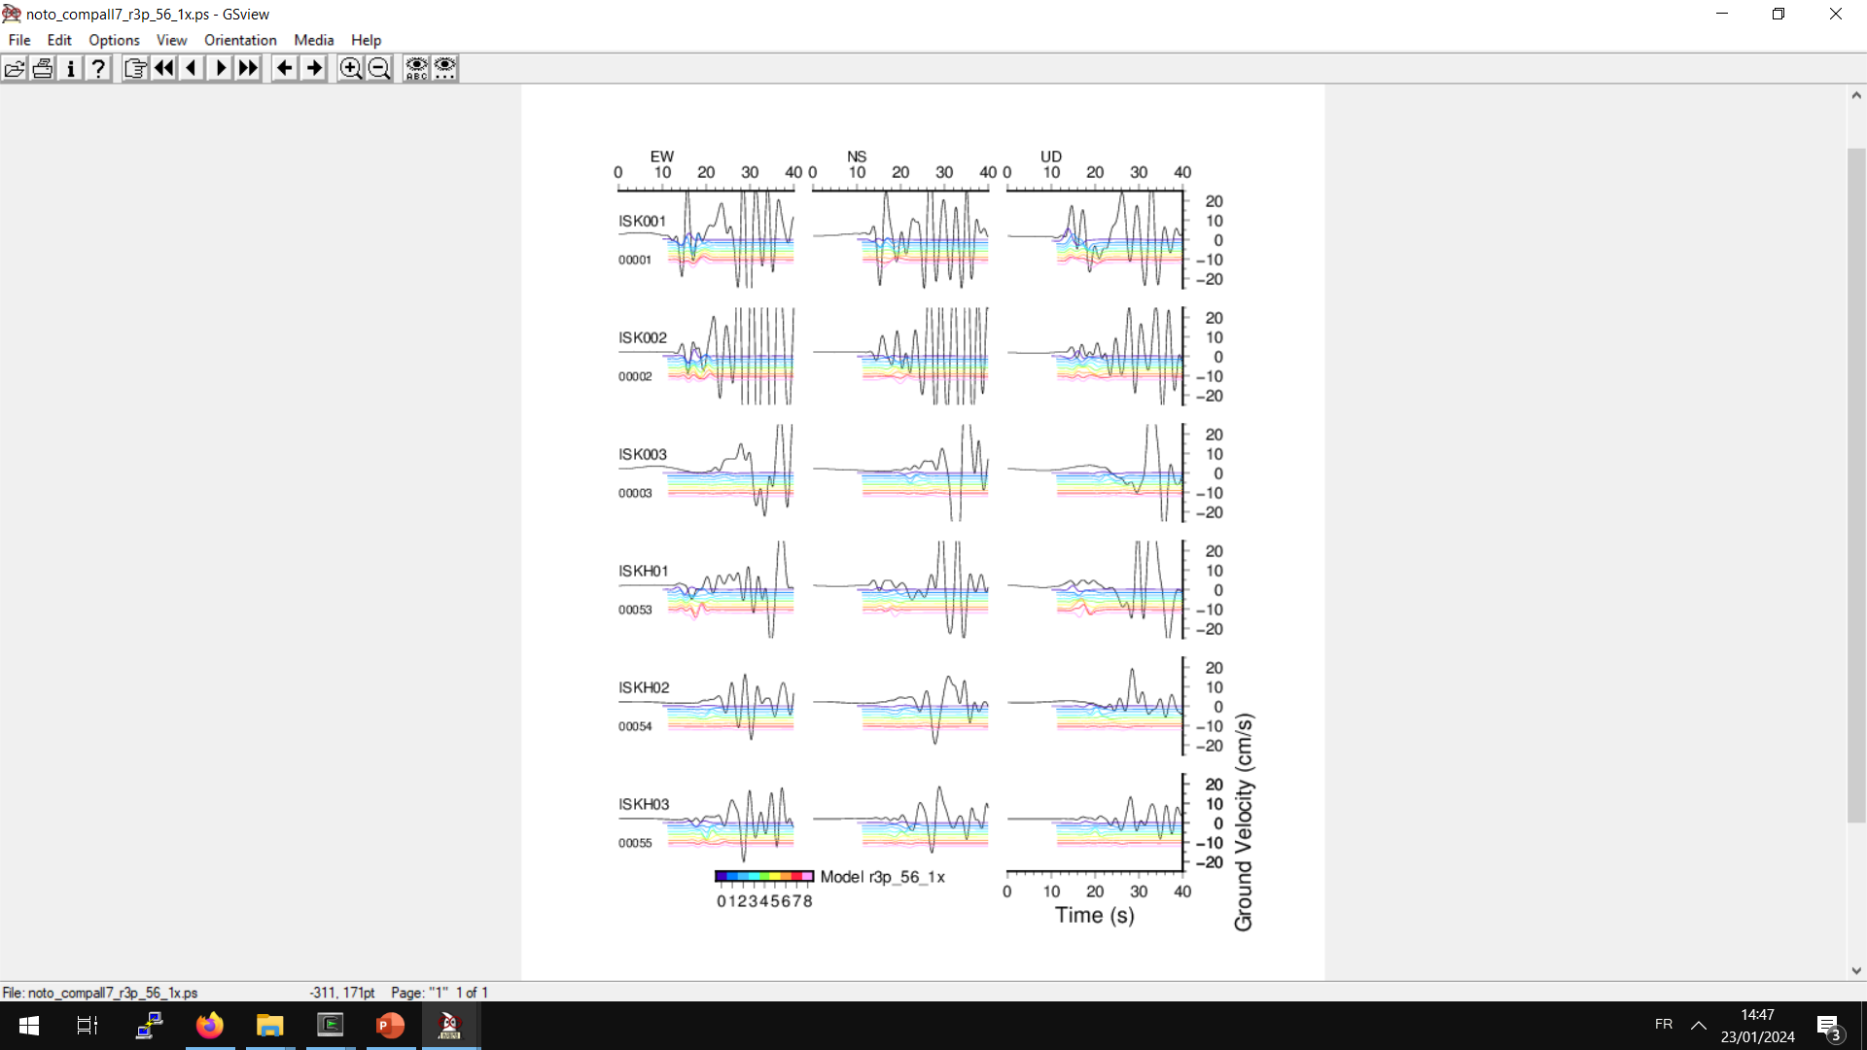
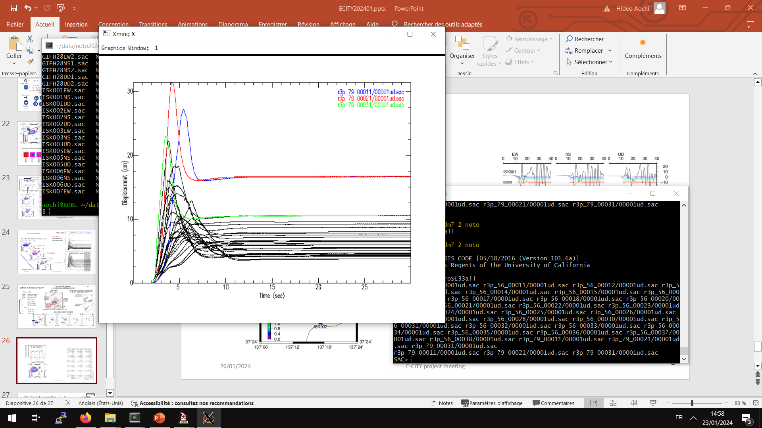
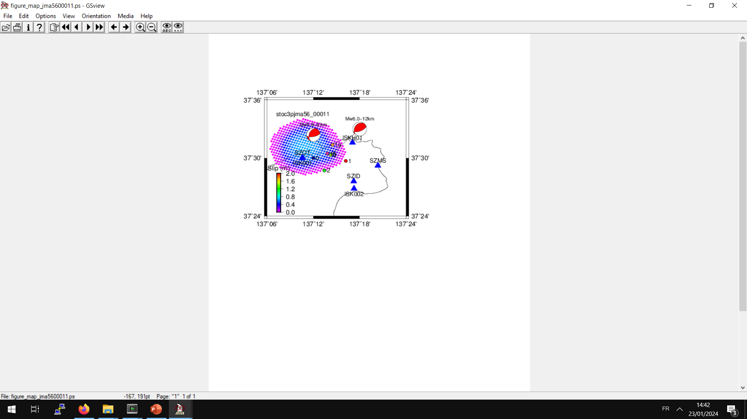
Influence of a smaller dip angle
Prevous one
Model 2 is better
Uz (cm)
ISK001~SZOT
JMA hypocenter at 10km
Model 2
Model 3

Slide 12
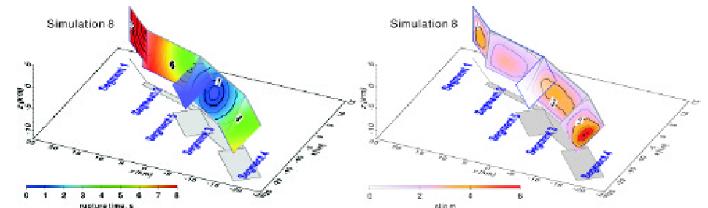
Remarks
SE dipping fault is reasonable from the uplift at ISK001 (~SZOT).
Rupture directivity is up-dip direction, going away from the hypocenter of M7.6.
Preferred stress drop is 6 MPa or less so that the rupture extends below station ISK001.

